Slide 1
Healthy People in Healthy Places Annual Public Health Report of the Director of Health and Wellbeing 2017 Accompanying slides
People & Health Intelligence Section Southwark Public Health 14 March 2018

Slide 2
GATEWAY INFORMATION
Report title: | Annual Public Health Report of the Director of Health and Wellbeing 2017 (accompanying slides)
Status: | Public
Prepared by: | Nora Cooke O’Dowd
Contributors: | Sophie Baird, Chris Williamson, Richard Pinder
Approved by: | Kevin Fenton
Suggested citation: | Healthy People in Healthy Places; Annual Public Health Report of the Director of Health and Wellbeing 2017 (accompanying slides). Southwark Council: London. 2018.
Contact details: | publichealth@southwark.gov.uk
Date of publication: | 14 March 2018

Slide 3
Annual Public Health Report forms part of Southwark’s Joint Strategic Needs Assessment process
BACKGROUND
The Joint Strategic Needs Assessment (JSNA) is the ongoing process through which we seek to identify the current and future health and wellbeing needs of our local population.
The purpose of the JSNA is to inform and underpin the Joint Health and Wellbeing Strategy and other local plans that seek to improve the health of our residents.
The JSNA is built from a range of resources that contribute to our understanding of need. In Southwark we have structured these resources around 4 tiers:
This document forms part of those resources.
All our resources are available via: www.southwark.gov.uk/JSNA
APHR
JSNA Factsheets
Health Needs Assessments
Other Intelligence Sources
Tier I: The Annual Public Health Report provides an overview of health and wellbeing in the borough.
Tier II: JSNA Factsheets provide a short overview of health issues in the borough.
Tier III: Health Needs Assessments provide an in-depth review of specific issues.
Tier IV: Other sources of intelligence include Local Health Profiles and national Outcome Frameworks.
Slide 3

Slide 4
INTRODUCTION
This slide deck provides in Microsoft PowerPoint format the content delivered in the Annual Public Health Report of the Director of Public Health 2017 – the original report can be found at http://www.southwark.gov.uk/health-and-wellbeing/public-health/for-professionals?chapter=2

Slide 5
How places and spaces are designed, maintained and evolve is vital to health and wellbeing
PLACE & HEALTH
The places in which we are born, live, work and age influence our health and wellbeing
These places can be shaped to enable healthy lifestyles, supporting healthy eating and physical activity and participation in the community and in local activities
Place-shaping is a highly important concept for those involved in both revitalising existing, and building new communities
New development can affect the character of a place and this is therefore a process that needs to be managed
Local authorities are strategic leaders in place-shaping
Place-shaping is an active process which responds to residents’ ambitions and aspirations
Southwark is currently exploring an improved understanding and relationship with developers through the TCPA’s* Developer & Wellbeing programme
Local authorities can work with partners towards a shared vision for health through place-shaping that can account for local health needs
Healthy places are those which enable:
connection with others
healthy affordable homes
active living & travel
affordable quality food
safe, attractive public spaces for play & recreation
contact with nature in everyday life
access to quality services & amenities
* Town and Country Planning Association

Slide 6
Regeneration has a fundamental role in improving the health, wellbeing and life chances of communities
THE ROLE OF REGENERATION
Urban regeneration is one of many options available for shaping place to improve health and wellbeing by influencing the built and social environment
Southwark is delivering some of Europe’s most exciting and complex regeneration schemes which are helping to shape neighbourhoods
Regeneration is too often only considered in terms of the built environment and the physical conditions in which we live
In Southwark our approach to regeneration is also about ensuring access to quality services and amenities and supporting the creation of jobs
Place-shaping through regeneration will be critical to help tackle the wider social determinants of health
Improving wellbeing and population health in Southwark will require action on many fronts with a ‘whole council approach’ that drives regeneration
Evidence suggests that this may be achieved by ensuring that communities and health and wellbeing are at the centre of our regeneration process
In Southwark we are integrating health and wellbeing into planning
Strategic policies within the New Southwark Plan aim to encourage healthy lives by tackling the causes of ill-health and inequalities in Southwark
In our major regeneration areas we are also working on evidence-informed heath plans, charters and outcome frameworks to ensure that regeneration impacts positively on health and wellbeing

Slide 7
We have an opportunity to work towards achieving the best possible outcomes from redevelopment & renewal
MAKING REGENERATION WORK FOR EVERYONE
Engaging and empowering local communities can improve community health and wellbeing
Evidence suggests that local communities must be engaged from the earliest point to be involved in co-identification of needs and co-design of solutions, and to bridge communities to local resources
This also promotes equity and increases people’s control over their health and lives, which are key to addressing health inequalities
The Southwark Conversation provides a rich source of information to help us further shape our borough
We will be working closely with partners across the borough to draw out implications for how we create healthier urban environments and will continue listening to communities
We will aim to create healthier places where the ‘healthier choice is the easier choice’
Part of this is looking at opportunities for integration, co-location and bringing services closer to communities and will help us to drive improvement and equity in population health both within and outside services
We are developing high level indicators which will enable us to assess inequalities in health across the borough
These will measure not just how regeneration impacts on people in local areas, but also the benefits that extend to people in other parts of the borough

Slide 8
Southwark is shaping place for health and wellbeing and reducing health inequalities through regeneration
SHAPING PLACE FOR HEALTH AND WELLBEING
There are five key recommendations to accelerate progress and demonstrate the impact of this important strategic imperative:
Develop and enhance cross-council governance, partnership and communication opportunities on social regeneration efforts to raise awareness, facilitate collaboration, and encourage more systematic evaluation of the opportunities and impact of urban renewal to improve health and wellbeing, reduce inequalities and improve life chances.
Ensure local health and wellbeing plans are in place for all major regeneration efforts taking place across the borough and that these are developed through wide engagement with local communities and stakeholders.
Further accelerate the use of local health, social and other relevant data into local planning decisions to ensure that a more comprehensive understanding of the wellbeing needs and potential health and inequalities impacts are considered.
Develop a standard set of key indicators for social regeneration, working collaboratively with a wide range of partners including local communities, to guide the evaluation of all urban renewal projects in the borough.
Develop and maintain robust governance, communication and other opportunities to support community participation and engage key stakeholders on the Council’s progress on social regeneration

Slide 9
The population of Southwark is set to continue to grow, increasing by 20% to over 370,000 in 2026
POPULATION PROJECTIONS
Home to some 313,000 people, Southwark is a patchwork of communities: from leafy Dulwich in the south, to bustling Peckham and Camberwell, and the rapidly changing Rotherhithe peninsula. Towards the north, Borough and Bankside are thriving with high levels of private investment and development.
The population of Southwark has been growing since the late 1980s, surpassing 300,000 inhabitants in 2014.
Growth is set to continue across almost all areas of the borough in the next decade. In particular, redevelopments around Old Kent Road, South Bermondsey and Elephant and Castle, will lead to significant population increases in these communities.
Local population projections used suggest that the population could increase could by a further 20% between 2016 and 2026
Population projections in Southwark, 2011-26
References
GLA 2017, 2015 Southwark Borough Preferred Option Projection

Slide 10
Southwark is a young borough, with a large proportion of young working age population
MEDIAN AGE IN SOUTHWARK
Southwark has a comparatively young population, with median age of 32.9 years, compared to 34.8 years in London and 39.8 years in England.
Some 92% of Southwark’s population are under the age of 65: a much higher proportion than the national average of 82%.
The young average age of the borough, stems not from a large number of children, but from a large number of young working age residents. Over 40% of the Southwark population consists of those aged 20 to 39, compared to 34% in the rest of London.
Over the coming decade our population is predicted to grow older:
The largest absolute population increase is expected in those aged 35-44, by around 18,000
The largest relative increase is predicted for those aged 60-69 (52%)
Age and sex distribution of the population in Southwark, London and England, 2016
Reference
Greater London Authority 2016-based borough preferred population projections

Slide 11
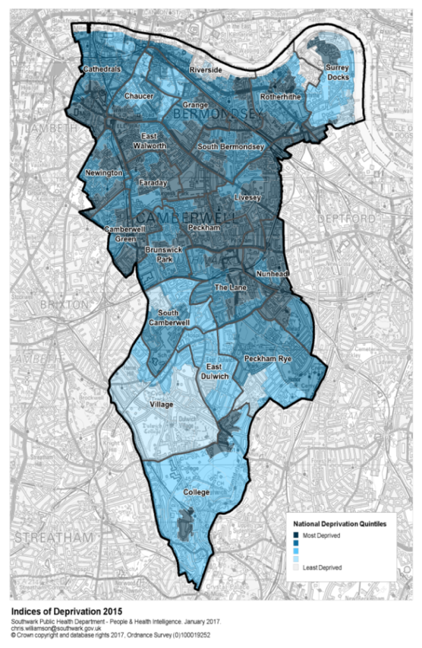
There is deprivation across the borough, with 38% in the highest quintile for deprivation nationally
DEPRIVATION
Deprivation has an important impact on health, as more deprived areas have higher prevalence of behavioural risk factors, underpinned by inequalities in the broad social and economic circumstances which influence health.
Southwark is the 40th most deprived of 326 local authorities in England and ninth most deprived out of 32 local authorities in London
There is significant variation in deprivation across the borough, with around 119,000 (38%) Southwark residents living in communities ranked in the 20% most deprived areas nationally.
The most deprived areas are situated in Peckham through to Elephant and Castle in the north-west. However, there are pockets of deprivation across the borough. Parts of the river front and Dulwich are the least deprived parts of the borough.
By contrast, only around 6,700 (2%) of residents live in communities considered the least deprived nationally.
Around 15,000 children (28%) in Southwark aged under 16 live in low income families
Reference
Greater London Authority 2016-based borough preferred population projections

Slide 12
Southwark is both ethnically and culturally diverse, particularly among those under 20
DIVERSITY
Southwark is a diverse borough with people from a wide range of ethnicities and backgrounds. Over 120 languages are spoken here, and 11% of households have no members who speak English as a first language.
Just over half (54%) of Southwark’s population is of white ethnicity, a quarter (25%) black and a third of Asian (11%) or other (10%) ethnicities.
This differs from the rest of London where a considerably smaller proportion (13%) identify as black and a considerably larger proportion identify as Asian (21%).
The ethnic diversity of the borough varies markedly across age groups and the population under 20 is much more diverse than other age groups, with a similar proportion of young people from white and black ethnic backgrounds.
According to the 2011 census, 39% of Southwark residents were born outside the UK, showing not only the ethnic diversity of the borough, but also the cultural diversity.
Population of Southwark in 10-year age bands, by ethnicity 2016
References
GLA 2016, Round trend-based ethnic group projections, 2015

Slide 13
Life expectancy at birth has increased in Southwark, by four years for women and five years for men
LIFE EXPECTANCY
Life expectancy at birth has been increasing steadily over time. This is true across London and England, but the improvement has been more pronounced in Southwark.
In 2014-16, life expectancy at birth for men was 79.1 years and 83.8 years for women in Southwark.
Between 2001-03 and 2014-16, the average number of years that a new-born baby would expect to live, based on contemporary mortality rates, increased by four years for women and five years for men.
However, life expectancy in Southwark is still below the London average and ranks 26 out of the 32 boroughs in London for both men and women.
Trends in life expectancy for men, 2001-03 to 2014-16
Trends in life expectancy for women, 2001-03 to 2014-16
Reference
ONS 2017, Life expectancy at birth by local areas, UK, 2001-03 to 2014-16

Slide 14
The gap in life expectancy between Southwark and London has been narrowing, but deprivation gap remains
LIFE EXPECTANCY
Whilst there has been a significant increase in life expectancy in Southwark over time, this improvement has not been the same across all our communities.
The range in years of life expectancy from the most to least deprived areas in Southwark was 5.5 years for women in 2014-16 and 9.5 years for men. This discrepancy has been increasing over time for men, but has stayed roughly the same for women.
In 2014-16, life expectancy for men in Southwark was 1.3 years below the London average and 0.4 years for women. These gaps have been narrowing over time and have decreased by one-third for men and by half for women since 2001-03.
Slope index of inequality in Southwark, 2010-12 to 2013-15
Male | Life expectancy at birth |  | Change over time
 | 2001-03 | 2014-16
Southwark | 74.0 | 79.1 | + 5.1 years
London | 76.0 | 80.4 | + 4.4 years
Southwark/London gap | 2.0 | 1.3 | - 33%
Female | Life expectancy at birth |  | Change over time
 | 2001-03 | 2014-16
Southwark | 79.9 | 83.8 | + 3.9 years
London | 80.8 | 84.2 | + 3.4 years
Southwark/London gap | 0.9 | 0.4 | - 49%
Reference
ONS 2017, Life expectancy at birth by local areas, UK, 2001-03 to 2014-16
Public Health Outcomes Framework, Slope index of inequality in life expectancy at birth

Slide 15
There is a two decade gap between life expectancy and healthy life expectancy
HEALTHY LIFE EXPECTANCY
Whilst our residents are living longer, the length of the time spent living in good health is also an important factor. Healthy life expectancy is often considered a measure of whether we are adding life to years, as well as years to life.
In 2014-16, there was a 17.9 year gap between life expectancy and healthy life expectancy for men and a considerably larger 21.2 year gap for women.
National intelligence indicates that not everyone can expect the same number of years spent living in good health. The gap in healthy life expectancy between the most and least deprived areas of the country stands at 19 years for both males and females.
Gap in life expectancy in Southwark, by sex 2014-16
References
ONS 2017, Health state life expectancy at birth and at age 65 by local areas, UK

Slide 16
Southwark has among the highest levels of excess weight in the borough
CHILDHOOD OBESITY
The National Child Measurement Programme measures the height and weight of children in Reception (aged 4-5 years) and Year 6 (aged 10-11 years) in state maintained primary schools across England.
Obesity among children in Southwark is consistently above London and national levels. In 2016-17, Southwark had the third highest level of excess weight (overweight and obese) out of the 32 London Boroughs for children in Reception (26%) and fourth highest for children in Year 6 (43%).
Excess weight and obesity in Reception is significantly higher than the Southwark average in the areas immediately south of the Old Kent Road, from Peckham, through to Walworth and Elephant and Castle in the North West.
By Year 6 there is little significant difference across the borough, indicating a whole population approach is required by this age.
Percentage of children who are overweight or obese in Reception and Year 6, 2016-17
References
National Child Measurement Programme- England, 2016-17

Slide 17
We will continue our work with partners across the borough to reduce the obesogenic environment
CHILDHOOD OBESITY
Key achievements in 2017
In 2017, we enhanced our commitment to early years by progressing to Stage 1 Baby Friendly accreditation, commissioning the Breastfeeding Welcome Scheme, and becoming a Healthy Early Years pilot borough. These initiatives will further develop in 2018.
In 2017, we linked public health and planning policy teams to ensure resident and community health is a key consideration of all Council planning decisions.
In 2017, we were formally recognised by the GLA and Sustain for our work addressing food poverty across the borough. We are currently developing a Food Poverty Action Plan to deliver targeted work using a strategic, coordinated approach with community partners.
Key areas of work for 2018
In 2018, we will work to improve the confidence and competence of health and non-health professionals to effectively communicate healthy weight messages through a newly commissioned online training service.
In 2018, we will increase levels of physical activity by developing tailored support to schools with the highest levels of excess weight and by piloting a unique Clinical Advice Pad prescribing physical activity to residents.
In 2018, we will collaborate with Guys and St Thomas’ Charity, local faith groups and other Council departments to develop sustainable, community-driven interventions around obesity and multiple long term conditions to extend the reach of healthy weight services across the borough.

Slide 18
Southwark has the second highest rate of new STI diagnosis in England
SEXUAL HEALTH
There were 8,117 new STI diagnoses in Southwark in 2016. With a rate of 2,628 new STI diagnoses per 100,000 population in 2016, Southwark has almost double the rate of STI diagnoses in London, and is the second highest of any borough in England, behind neighbouring Lambeth.
The most common STIs in Southwark are chlamydia, gonorrhoea and genital warts
56% of all new STIs diagnoses were in men who have sex with men.
Just over one-third of new STI diagnoses were made up of those aged 15 to 24. Young people are also more likely to become re-infected with STIs, contributing to infection persistence. In Southwark, an estimated 14% of 15-19 year old women and 13% of 15-19 year old men presenting with a new STI from 2012 to 2016 became re-infected within 12 months.
The overwhelming majority (84%) of all new STI diagnoses in Southwark occurred in the two most deprived quintiles.
New STI diagnosis per 100,000 in Southwark 2012-16
References
PHE 2017, Sexual and Reproductive Health Profiles
PHE 2017, Southwark Local authority HIV, sexual and reproductive health epidemiology report (LASER): 2016

Slide 19
Southwark has the second highest rate of HIV prevalence in England, but rate of new diagnosis is declining
HIV
Levels of HIV in Southwark are particularly high, with the borough having the second prevalence in England, behind neighbouring Lambeth. There are currently 2,557 people living in the borough who have been diagnosed with HIV.
In 2016, more than 100 people in Southwark were newly diagnosed with HIV.
While the rate in Southwark is significantly higher than London, the gap has narrowed significantly time as new diagnoses in Southwark have more than halved since 2011.
Late diagnosis is the most important predictor of HIV-related morbidity and short-term mortality and this has also improved in Southwark over time. However, still over one-third (37%) of adults newly diagnosed with HIV were diagnosed late in Southwark between 2014 and 2016.
New HIV diagnosis rate per 100,000 in Southwark 2016
References
PHE 2017, Sexual and Reproductive Health Profiles
PHE 2017, Southwark Local authority HIV, sexual and reproductive health epidemiology report (LASER): 2016

Slide 20
We are developing a strategy with Lambeth and Lewisham to reduce the burden of poor sexual health
SEXUAL HEALTH
Key achievements in 2017
Between 2015 and 2016 (latest available data), new diagnoses of STIs declined by 9% and new diagnoses of HIV declined by 40%, while rates of testing continued to increase.
In 2017, we agreed integrated sexual health contracts with KCH and GSTT, maintaining high quality services while reducing contract costs by £9.3m over the next 4.5 years.
In 2017, an innovative integrated young peoples’ wellbeing service was commissioned to better meet the multiple needs of young people, including sexual health, drugs and alcohol, and mental wellbeing. We are currently working with the service provider (Brook and CGL) to embed the new service.
Key areas of work for 2018
In 2018, we will develop a new sexual and reproductive health strategy in partnership with Lambeth and Lewisham councils, which will include annual action plans.
Following a pilot, we will explore options for access to oral contraception online, in order to reduce GP appointments and additional demand on specialist GUM clinics.
We will develop and implement, in partnership with Lambeth Council, a new model for the delivery of pharmacy sexual health services for our residents, with the aim of improving access to contraceptive options and reducing repeat use of emergency contraception.

Slide 21
A considerable number of people in the borough experience mental ill health
MENTAL HEALTH
Mental health and a sense of wellbeing are central to living a purposeful, healthy and enjoyable life, because there is no health without mental health
Almost 50,000 adults in Southwark experience a Common Mental Disorder, which comprises different types of depression and anxiety, and this is expected to rise.
All types of CMD are more prevalent in women than men: 1 in 5 women report experiencing CMD, compared to 1 in 8 men.
The gender gap is particularly pronounced among those aged 16-24, where more than three times the number of women have a common mental disorder than men.
Severe mental illness refers to psychotic conditions such as schizophrenia and bipolar affective disorder, which affects 1.2% of Southwark residents (4,000 people), compared to 1.1% in London. The prevalence of SMI increases with age among both men and women, peaking among those in their fifties.
In contrast to the estimated prevalence of common mental disorders, the number of men diagnosed with SMI in Southwark in greater than women across each age group up to 70.
References
NHS Digital, Adult Psychiatric Morbidity Survey, 2014
SMI Register, Southwark General Practice; EMIS Web Extract, December 2017

Slide 22
Suicide is more common among men and self-harm among women and young people
SUICIDE & SELF-HARM
Every suicide is a tragic event and has devastating impacts on families, friends and communities. In Southwark we know that many suicides are preventable.
Southwark is one of five London boroughs to report higher suicide rates than the national average in 2013/15.
For each of the last three years, between 14 and 32 Southwark residents have taken their own lives. Almost four out of five local suicides were among men.
Whilst suicide is more common among men, women are much more likely to report having self-harmed.
In 2015/16, there were 286 emergency hospital admissions for intentional self-harm in Southwark, 62% of these were women.
Young people are also more likely to self-harm. The admission rate for young people is comparable to the overall rate for London, but significantly lower than the national average
Directly-standardised rates of hospital admission as a result of self-harm per 100,000 population aged 10-24
References
ONS 2017, Suicides in England and Wales by local authority
PHE, Hospital admissions as a result of self-harm, 2011/12 to 2015/16

Slide 23
Continually working with stakeholders is key to promoting good mental health and reducing suicide
MENTAL HEALTH
Key achievements in 2017
Southwark’s Public Health Team have established a new multi-stakeholder Suicide Prevention Steering Group and facilitated the co-production of a local Suicide Prevention Strategy and Action Plan 2017-2022.
Southwark Council and Southwark NHS Clinical Commissioning Group have worked in partnership to develop a Joint Mental Health and Wellbeing Strategy 2018-2021.
In order to improve care for patients in crisis in A&E, Southwark CCG and Southwark Council have been part of the implementation of a centralised ‘Place of Safety’ on the South London and Maudsley hospital site.
Key areas of work for 2018
To support the commitment of the Council and Southwark CCG to prevent mental ill health and promote wellbeing, we will work with local partners to complete a needs assessment focusing on mental health promotion and wellbeing.
We will work with Southwark CCG to ensure the integration of physical health and mental health in Southwark, including work on long term conditions and mental health linked to the delivery of the Southwark population segmentation model.
We will create an improved pathway to promote recovery and step down from high support mental health accommodation placements and also review placements that are out of borough to ensure quality care is being delivered, and ensure that care is provided in Southwark where appropriate.

Slide 24
Prevalence of diagnosed long-term conditions in Southwark is similar or lower than London
LONG TERM CONDITIONS
Data from General Practices provide a register of recorded disease prevalence for a number of Long Term Conditions (LTCs).
Hypertension (11%), Depression (8%), and Diabetes (6%) are the most prevalent measured diagnoses in Southwark, mirroring the national picture.
Increasingly, patients have to manage more than one LTC at a time. Approximately 1% of the registered Southwark population have three or more chronic conditions (3,500 patients). More than half of people with multiple LTCs are aged 70 and over.
Diagnosed disease prevalence in 2016/17
Condition Group | Condition | IHL | QHS | Southwark |  | London
 |  |  |  | Cases | Prevalence | Prevalence
Mental Health & Neurological conditions | Dementia | 0.5% | 0.3% | 1,216 | 0.4% | 0.5%
 | Depression (18+) | 7.6% | 7.4% | 19,562 | 7.5% | 6.6%
 | Epilepsy (18+) | 0.6% | 0.5% | 1,377 | 0.5% | 0.6%
 | Learning Disabilities (18+) | 0.3% | 0.3% | 1,001 | 0.3% | 0.4%
 | Mental Health | 1.3% | 1.2% | 4,001 | 1.2% | 1.1%
Cardiovascular conditions | Atrial Fibrillation | 0.8% | 0.7% | 2,470 | 0.8% | 1.1%
 | CHD | 1.4% | 1.4% | 4,401 | 1.4% | 2.0%
 | Stroke & TIA | 1.0% | 0.8% | 2,900 | 0.9% | 1.1%
 | Heart Failure | 0.4% | 0.5% | 1,475 | 0.5% | 0.5%
 | Hypertension | 11.1% | 10.2% | 34,338 | 10.6% | 11.1%
Respiratory conditions | COPD | 1.1% | 1.6% | 4,415 | 1.4% | 1.1%
 | Asthma | 4.6% | 4.2% | 14,138 | 4.4% | 4.6%
High dependency & other LTCs | Cancer | 1.5% | 1.4% | 4,732 | 1.5% | 1.8%
 | Chronic Kidney Disease (18+) | 1.9% | 2.4% | 5,630 | 2.2% | 2.4%
 | Diabetes (17+) | 6.5% | 5.8% | 16,121 | 6.1% | 6.5%
References
1. NHS Digital Quality Outcomes Framework 2016/17

Slide 25
We aim to promote early detection of long term conditions and improve outcomes
LONG TERM CONDITIONS
Key achievements in 2017
Between 1 April 2014 and 31 December 2017, 31,686 Health Checks have been completed in Southwark.
We provided support to the clinical effectiveness programme in Southwark CCG, including intelligence and the delivery of Protected Learning Time (PLT) sessions for local GPs.
We conducted cardiovascular disease (CVD) risk factors needs assessment, with a focus on primary prevention, to drive better outcomes for CVD at a local level.
Key areas of work for 2018
We will develop and pilot a Digital NHS Health Check which is easy to access and simple to use to further increase uptake and improve health outcomes.
Further work is planned for 2018 to assess the CVD profile locally in terms of secondary prevention, and explore benefits of using prevalence and/or budget modelling approaches while setting priorities for public health interventions in the future.
We will continue to support the Southwark CCG in their programme of work to improve outcomes for people with long term conditions.

Slide 26
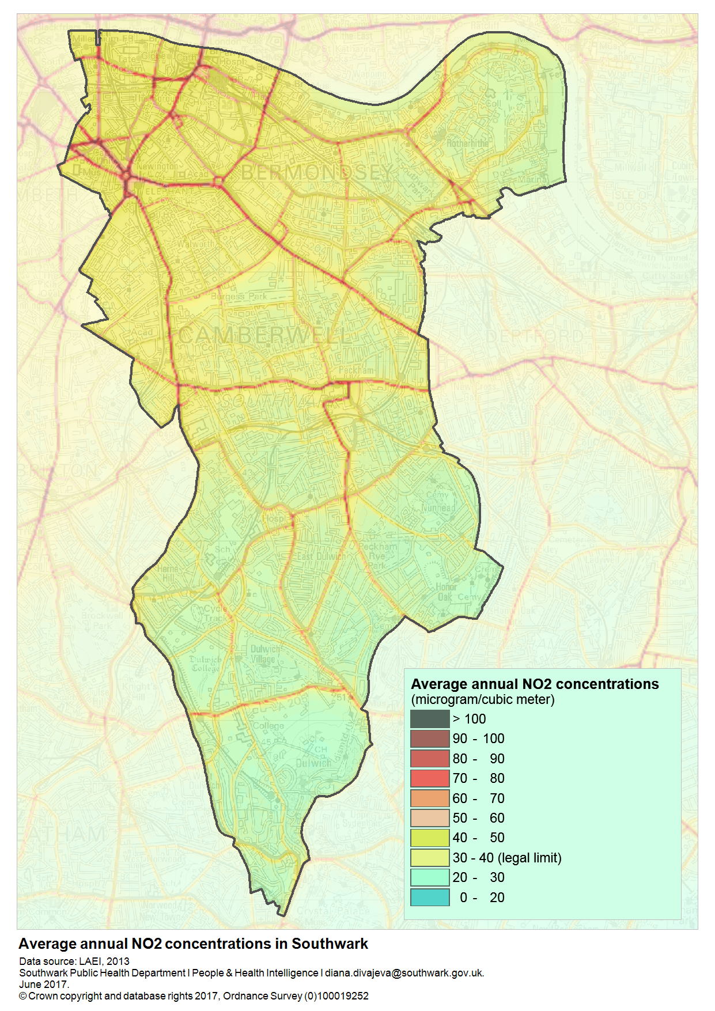
Air quality in Southwark is improving, but roughly 80 deaths annually are attributable to particulate matter
AIR QUALITY
Air pollution data show a decrease in total emissions for nitrogen oxides (NOx) and particulate matter (PM) in Southwark.
NOx is the largest pollutant in Southwark with around 1,200 tonnes emitted in 2013 alone, over a quarter less than in 2008.
Around 110 tonnes of PM10 were emitted in Southwark in 2013 – a decrease of a fifth since 2008.
Around 56 tonnes of PM_{2.5} were emitted in 2013 – a decrease of over a quarter since 2008.
Exposure to poor air quality is associated with both ill-health and premature death.
As well as impacting health conditions, long-term exposure to air pollution can increase the risk of premature mortality and PM_{2.5} is thought to have an effect equivalent to over 80 deaths per year in Southwark
Reference
Greater London Authority, London Atmospheric Emissions Inventory (LAEI) 2013

Slide 27
Tackling air quality involves engagement with schools and wider community partners
AIR QUALITY
Key achievements in 2017
In 2017 Southwark Council undertook a needs assessment on the health impacts of air quality and a new Air Quality Strategy and Action Plan for 2017-22.
The New Southwark Plan (currently out to consultation) includes a development management policy on air quality.
We have worked extensively with schools to identify and implement a variety of air quality measures to reduce children’s exposure to air pollution.
Key areas of work for 2018
We will be engaging NHS partners in Southwark identify opportunities to improve health outcomes for those most affected by air pollution.
We will continue to develop the air quality communications campaign and advocate for wider, regional action to address air quality.
We will promote School Travel Plans and increase the number of schools attaining TfL STARs Silver or Gold accreditation each year

Slide 28
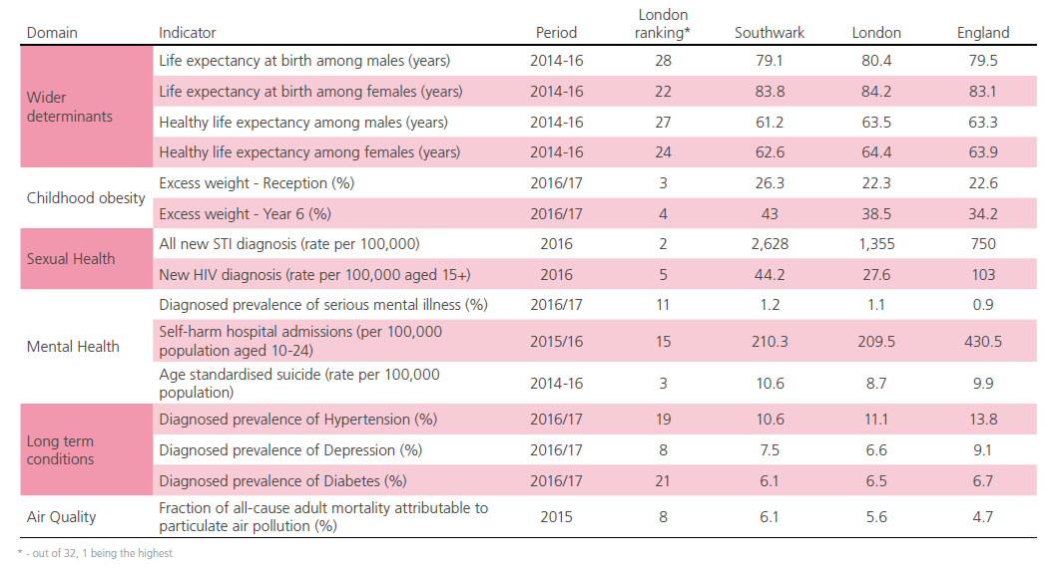
There are a range of indicators that give us an overview of the state of health in Southwark
KEY INDICATORS
Every suicide is a tragic event and has devastating impacts on families, friends and communities. In Southwark we know that many suicides are preventable.
References
PHE 2017, Public Health Outcomes Framework

Slide 29
Find out more at southwark.gov.uk/JSNA
People & Health Intelligence Section Southwark Public Health

