Slide 1
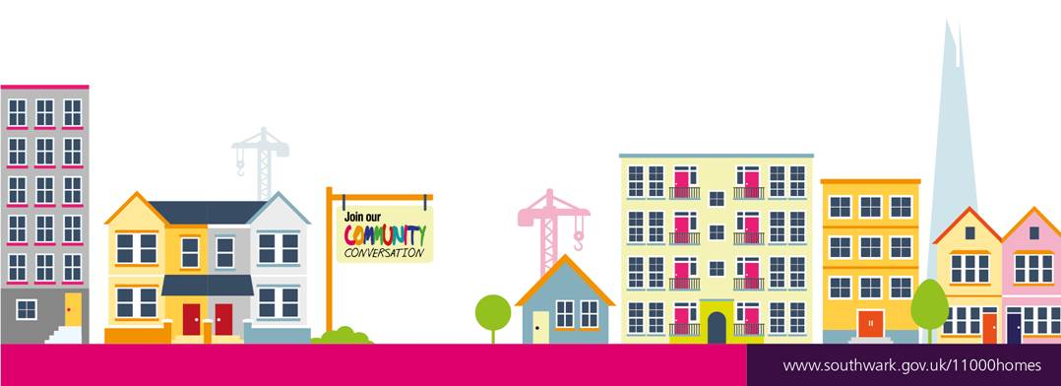


Kingston Estate
11,000 new council homes
Southwark Council is proposing to
build new homes for local people
on the Kingston Estate.
It is proposed to build 8 new homes
for rent (subject to planning) as part
of the Council’s programme to build
11,000 new council homes. The site
is made up of a small block of
garages situated off Dawes Street.

Slide 2
11,000 new council homes
Proposed Site

Slide 3
11,000 new council homes
We value the comments we received from you and hope that our feedback below will answer some of your questions.
Security
All our new homes will be built to the Secure By Design Standards. In addition the Police and the Fire Brigade are also consulted during the planning process, so that they can comment on the design proposed.
Improving the security of the estate will be included in the brief for the architect to work to. In particular entrances to the estate which are closest to East Street Market will be looked at during the design.
Refuse Improvements
Arrangements will be made for the refuse for the new homes. The Council wants to hear suggestions from residents on how litter could be reduced in the area.
Our Feedback to your Comments
www.southwark.gov.uk

Slide 4
Kingston Estate
Our feedback to your comments (cont’d)
Design
The work on the design of the new homes will be done jointly with local residents – this will include:
How high the building will be
Overlooking Issues
Landscaping
Dealing with Anti Social Behaviour
The Construction Period
The garages will be demolished – during this period, the contractor will make every effort to minimize any noise, disruption and pollution from the building works.
Site meetings and site inspections will be carried out regularly.

Slide 5
11,000 new council homes
Our feedback to your comments (cont’d)
5. Proximity to the development
Residents whose homes are close to the development site will have the opportunity to discuss their issues and concerns at planning stage and during the construction period. We will give you every help and assistance we can to minimize any disruption and address your concerns wherever possible.
Great Estates Consultation
During the consultation period you will have the opportunity to tell us what local improvements would make your estate a great place to live. We will then agree an agreed plan with residents for their delivery (subject to available funds finance and planning approval).
Our consultation process will continue throughout the design and development stages of the new council homes. You will be
involved in the most important decisions as we progress.
www.southwark.gov.uk

Slide 6
11,000 new council homes
Keeping in Touch
For the time being as a result of the Covid-19 situation, we are following the social distancing directive from Central Government and plan to carry out consultation online and via our consultation hub at:
www.southwark.gov.uk/Kingstonestateimprovements
From now on, we will keep the hub permanently open and all
our newsletters, general notification and updates on this
project will now be posted on the hub
www.southwark.gov.uk

Slide 7
11,000 new council homes
Keeping in contact with us
A dedicated New Homes consultation mailbox has been created for you to contact us if you have any queries; please use this mailbox to contact us rather than our individual email addresses. NHDTPhase5consultation@southwark.gov.uk

Slide 8
11,000 new council homes
Indicative Next Steps
May 2020 | Resident Project Group is set up
June 2020 | Council appoints Design Consultants / architects
Summer - Winter 2020 | Local Residents , Architects and the Council work together to develop the design of the development
Winter 2020 | Application for Planning Permission
Spring 2021 | Planning Approval is obtained
Winter 2022 | Council appoints Contractor
Winter 2022 | Meet The Contractor Event for Residents
Winter 2023 | End of the construction of the new Council Homes – Tenants move in.
www.southwark.gov.uk

