Slide 1


11,000 new council homes
Pynfolds Estate
Southwark Council proposes to develop approximately
Eight New Council Homes
For rent
on
Pynfolds Estate.
This is part of our commitment to help make lives better in the borough by building 11,000 new council homes by 2043.
The area is located in the corner of Cathay Street and Paradise Street where there is currently a parking court. It currently contains approximately 16 bays which provides off site parking
for permit holders.
www.southwark.gov.uk

Slide 2
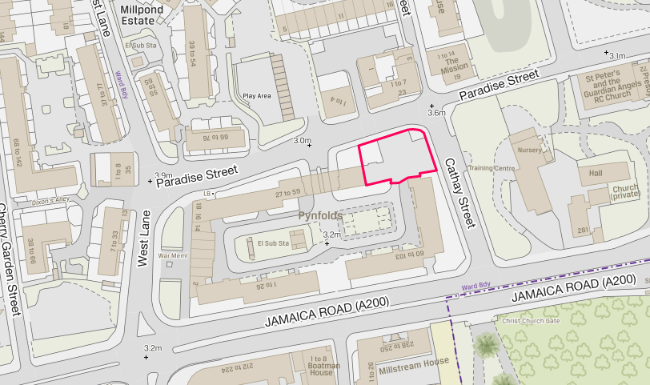
11,000 new council homes
Pynfolds Estate
Proposed Location for New Homes
www.southwark.gov.uk

Slide 3
11,000 new council homes
Our commitments
We are committed to building 11,000 new council homes across Southwark by 2043
Of these, 2,500 will be delivered by 2022
There are currently about 10,000 households on the housing waiting list and 2,000 families are in temporary accommodation
Pynfolds Estate is one of 80 sites across the borough that the council is currently developing for new council homes
Under our local lettings policy, a minimum of 50% of the new council homes will be for local tenants in housing need
Why we’re making them
A shortage of affordable housing is a top concern for our residents
The population of our borough is growing
To help meet the housing needs of future generations
To provide opportunities and strengthen communities
www.southwark.gov.uk

Slide 4
11,000 new council homes
Our Feed back To Your Comments
The consultation hub closed on 14th October 2019
An estate walkabout was also organised with residents and Ward Councillors
We value the comments we received from all residents.
Below is the Council’s feedback to what you said.
www.southwark.gov.uk

Slide 5
Our feed back to your comments (cont’d)
11,000 new council homes
We asked you what you would like us to consider in the development of the site.
Your responses:
Fear that the estate would feel enclosed as a result of the development
Issues around density
Issues around congestion and pollution
More refuse facilities
More pressure on shared facilities
Potential loss of daylight and open air
Loss of car park spaces
www.southwark.gov.uk

Slide 6
Our Feed back To Your
Comments (cont’d)
11,000 new council homes
How can we ensure that the proposed development will not impact on the daylight, congestion, pollution and the density of the estate?
  The concerns expressed by residents are at the heart of the planning process. Ensuring that there is sufficient sunlight and daylight for example is a key concern in all planning applications. Density issues, congestion, pollution and pressure on shared facilities, are all legitimate concerns and will be addressed in the planning application.
  The proposed development is a very small block that will not have a big impact on the existing built environment.
  In addition, residents will be invited to form part of a Project Group and they will be able to comment on the plans before they are submitted to planning. You will be party to discussions on the impact of the development and what can be done to manage that impact.
www.southwark.gov.uk

Slide 7
11,000 new council homes
Our feed back to your comments (cont’d)
Will there be a loss of car park spaces and will residents have to pay more for parking on the street. Can additional parking be provided within the estate?
  The amount of parking needed is considered alongside the facilities such as the need for amenity space and public transport during the planning process. In order not to make parking more difficult for existing residents, new residents will not be provided with parking spaces, except for disabled car spaces if required.
  Parking on the street is not affected by the development – usual conditions apply.
www.southwark.gov.uk

Slide 8
Our feed back to your comments (cont’d)
11,000 new council homes
Will the look, impact and visual aspects of the new development affect the value of the current leasehold properties on the estate?
  Residents are advised to seek independent advice on valuation matters.
  Informally and without prejudice, however, we are of the opinion that when new properties are built generally, it tends to increase the desirability of an area and improve its position in the property market.
www.southwark.gov.uk

Slide 9
Our feed back to your comments (cont’d)
11,000 new council homes
We are concerned about the condition of the existing blocks. Will the estate be refurbished?
  The process of resident consultation will include asking residents about works that they think are needed on the estate.
  Part of this program is about the Great Estates Program. This means that we are not just inserting new homes but making local improvements too.
We would like the garden in the middle of the estate to be upgraded and existing trees retained.
  We will include improving the local garden in the Community Brief that we want to develop where we are building new homes. This is about improving the lives of all residents and local residents can be involved in the planning and delivery of the improvements to the garden.
  As far as possible all trees will be retained.
www.southwark.gov.uk

Slide 10
11,000 new council homes
Our feedback (cont’d)
We would like the balconies on the ground floor to be replaced with gardens or patios. Would this be possible?
  Balconies are designed for the sole use of the household living in the property. Should gardens be created on what is now land for general use, they will not be personal gardens but gardens for the enjoyment of all residents. The possibility can be discussed during the resident Project Group meetings with the design team in terms of feasibility and planning. We cannot promise that this will be possible and we will need to consult with all residents.
Would you be able to provide a bicycle storage area?
  Absolutely, bicycle storage can be part of the planning application.
www.southwark.gov.uk

Slide 11
Our feedback (cont’d)
11,000 new council homes
Would you be able to provide refurbishment to the back of the shop’s on West lane as the windows and doors are broken?
  The shops should report this to the Property Services Team who are responsible for repairs to shop premises. This appears to be a simple repair matter that does not require to wait for the new homes to be built or for the planning application. If the shops have reported the repairs and have had difficulties in getting them done, they can contact the phone number at the end of this document and we will assist and advise.
Would it be possible to have a vehicle drop off point for residents that have mobility needs?
Of course.
www.southwark.gov.uk

Slide 12
11,000 new council homes
Consultation
As promised our consultation process will continue throughout the design and development stages of the new council homes. We want to make sure of you are involved in the most important decisions as we progress.
For the time being as a result of the current Covid-19 situation, we are following the social distancing directive from Central Government and plan to carry out our consultation online and via our consultation hub at:
www.southwark.gov.uk/Pynfoldsestatedevelopment
From now on, we will keep the hub permanently open and all our newsletters, general notification and updates on this project will now be posted on the hub.
www.southwark.gov.uk

Slide 13
11,000 new council homes
Keeping in contact with us
A dedicated New Homes consultation mailbox has been created for you to contact us if you have any queries; please use this mailbox to contact us rather than our individual email addresses.
NHDTPhase5consultation@southwark.gov.uk
www.southwark.gov.uk

Slide 14
11,000 new council homes
Indicative Next Steps
May 2020 | Resident Project Group is set up
June 2020 | Council appoints Design Consultants / architects
Summer - Winter 2020 | Local Residents , Architects and the Council work together to develop the design of the development
Winter 2020 | Application for Planning Permission
Spring 2021 | Planning Approval is obtained
Winter 2022 | Council appoints Contractor
Winter 2022 | Meet The Contractor Event for Residents
Winter 2023 | End of the construction of the new Council Homes – Tenants move in.
www.southwark.gov.uk

Slide 15
11,000 new council homes
Please remember to keep in contact with us with your comments and suggestions via our dedicated consultation mailbox rather than our individual email addresses at:
NHDTPhase5consultation@southwark.gov.uk
Make sure you provide your name, address and contact details.
If you’d like to talk to someone about this project, please contact:
Geeta Le Tissier (Project Manager)
Tel: 07743 813 888
Melanie Hill (Project Officer)
Tel: 07984 228 291
Looking forward to hearing from you.
www.southwark.gov.uk

