Slide 1

Keep Smiling Through
Black Londoners on the Home Front
Notes:
This resource is based on the very successful exhibition devised by the Cuming Museum and author Stephen Bourne in 2008-10 and which resulted in an exhibition in 2009 called Keep Smiling Through. Its aim is to highlight the role of Black Londoners during the Second World War.
Black Londoners were active in a variety of roles. They served their local communities and supported the war effort as doctors, nurses, entertainers, civil servants, government and BBC employees.
Many black Londoners volunteered as civilian defence workers, such as firewatchers, air raid wardens, stretcher-bearers and mobile canteen personnel. These roles were crucial to the home front, which was the name given to the activities of the civilian population in a country at war.
Important too were the contributions made by Britain’s colonies. From 1941 the British government began to recruit service personnel and skilled workers from Africa and the Caribbean. Fund-raising drives in the colonies supplied much needed equipment to Britain’s war effort. This support was vitally important in boosting the moral of the British people during the war.

Slide 2
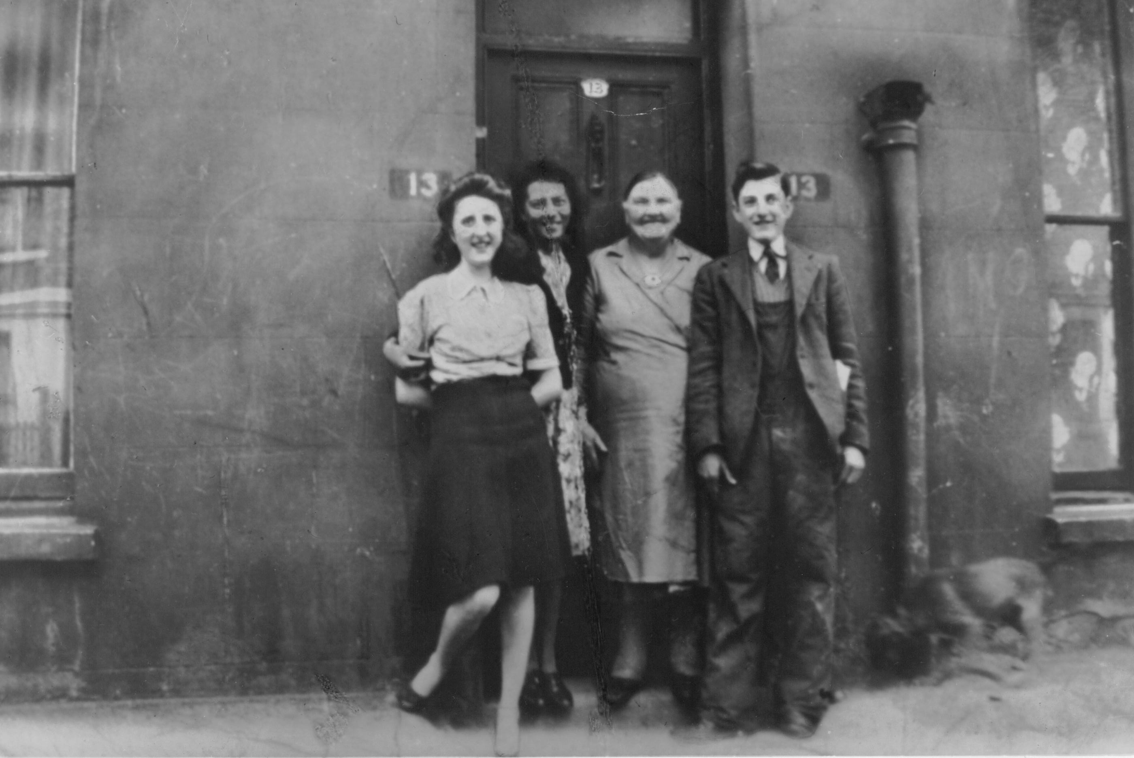
Esther Bruce and family
Notes:
Esther Bruce’s story
Esther spent much of the war as a Fire Guard at Fulham and Brompton hospitals. She and her father Joseph were the only black members of their tight-knit community.
Armed with a stirrup pump, a helmet and an armband labelled Fire Guard, Esther watched for incendiary bombs and fires from the hospital roofs during air raids. It was a dangerous job. Incendiary bombs were filled with combustible chemicals and were dropped in clusters to start fires. Fire Guards were responsible for putting the fires out, although the bombs could explode at any moment.
Esther also experienced the hardship of food rationing. She was lucky to be able to ask her relatives in Guyana to send food parcels. Esther remembered “They were better off than us because the Americans were based there. Two weeks later a bloody great box arrived. Everything was in it, all sorts of tinned food…”

Slide 3
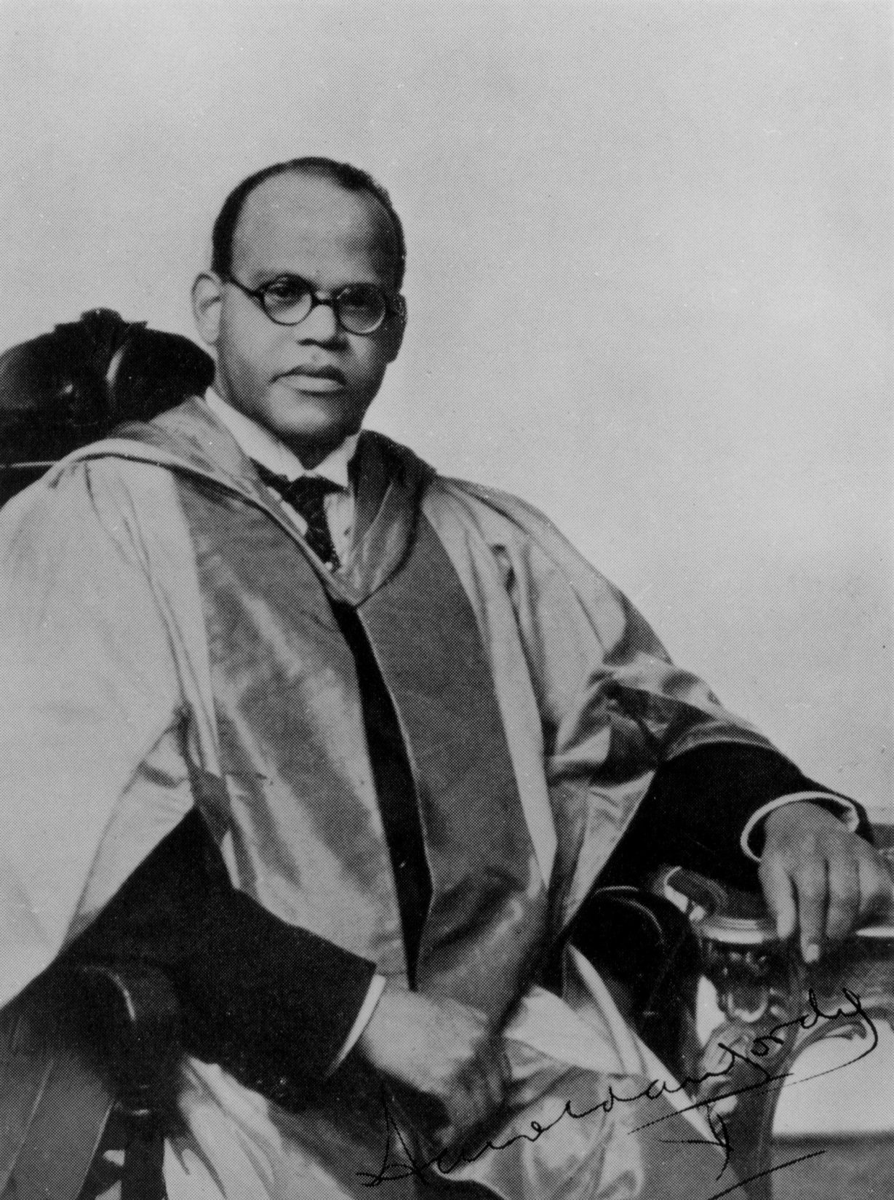
Dr Harold Moody
Notes:
Dr. Harold Moody came from a middle-class background, and he earned his living as a family GP in Peckham.
Born in Kingston, Jamaica in 1882, he qualified as a doctor in 1912 and started his own practice at 111 King's Road (now King's Grove), Peckham in 1913. That same year he married Olive Tranter, an English nurse, and they had six children.
He was not only a popular GP but also an ambassador for Britain’s Black community in the 1930s and 1940s, and an important figurehead who campaigned to improve the situation for African and Caribbean settlers in Britain.
Dr. Moody's experiences of hardship and racist attitudes led him to become one of the founders of the League of Coloured Peoples in 1931. Dr. Moody was its first president, and the LCP based itself at his second Peckham home. In 1922 Dr Moody had moved his family to 164 Queen's Road, a spacious, rambling Victorian house. This is now marked with an English Heritage Blue Plaque in Moody's honour.
On December 12, 1940 Dr. Moody went to Buckingham Palace when Her Majesty the Queen received on behalf of Britain a fleet of 35 mobile canteens which had been purchased from funds provided by the colonies.
In 1944 Dr. Moody was one of the first on the scene of the terrible V2 rocket incident in New Cross. Nearly 200 were killed and hundreds injured, mainly mothers and their children among the Christmas shopping crowds. The incident caused the country’s heaviest casualties of the war. Dr. Moody attended as part of a team called in from the surrounding area. They struggled night and day amidst the chaos and carnage to bring comfort to the survivors.
Dr Moody died in 1974 after a lifetime of service and remembered through Blue Plaques and a bust on display in Peckham library.

Slide 4
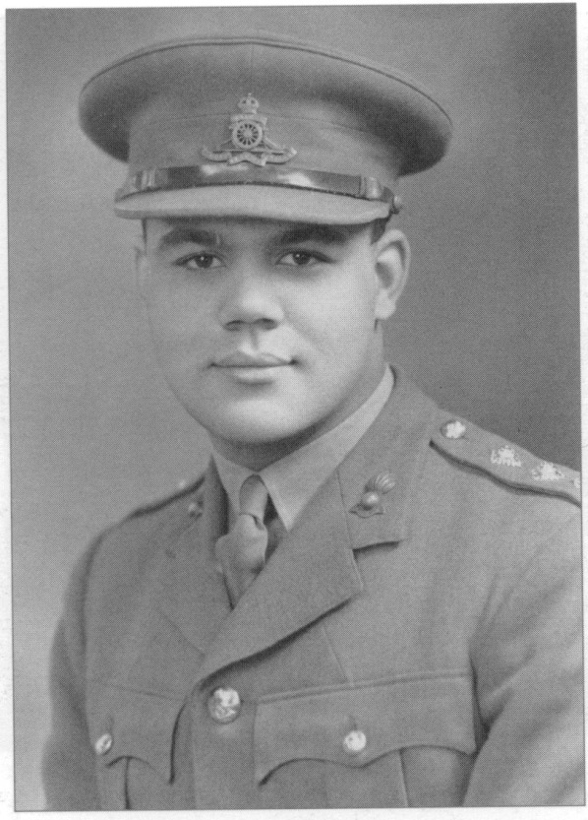
Colonel Charles Arundel Moody
Notes:
During the Second World War, five of Dr. Moody's six children received army or RAF commissions. In 1940 his son, Charles Arundel, born in Peckham, became the first Black officer to be accepted in the British Army when he joined the Queen’s Own Royal West Kent Regiment. Dr. Moody had protested to the Colonial Secretary about the ‘colour bar’ that existed in the armed services. As a result, the government relaxed the rules regarding voluntary enlistment and emergency commissions. Ronald Moody served in the RAF. His daughter Christine, and son Harold, both qualified as doctors and joined the Royal Army Medical Corps. They became captain and major respectively. His youngest son, Garth, was a pilot-cadet in the RAF. However, the Moody volunteers were among the very few Blacks appointed as officers in the army during the war.

Slide 5
EI Ekpenyon
We do not have an image of EI Ekpenyon so could we pop in any air raid poster from Patricia’s presentation?
Notes:
E. I. Ekpenyon
Ekpenyon Ita Ekpenyon, a Nigerian from the town of Calabar, originally came to Britain to study law. He began training as a warden with the Air Raid Precautions Service as soon as the war broke out in September 1939. As an Air Raid Warden in St. Marylebone, Ekpenyon worked as an official in charge of local arrangements for air raids. He was responsible for running air raid shelters, giving advice to his community, keeping lists of people living locally, helping with rescue work, and warning people about the blackout (during the war all outside lights were switched doff and people had to make sure that no lights could be seen from within their homes – hence people put up ‘blackout’ screens or curtains).
During the war Ekpenyon made several broadcasts for BBC radio in Calling West Africa and, in June 1942, in the company of Sir Donald Cameron, the ex-Governor General of Nigeria, he visited a war factory. The visit was marked by the unveiling of the Katsina tank, sent to Britain from the Northern Provinces of Nigeria. After the war, Ekpenyon hoped to resume his law studies, but financial considerations forced him to work as a postman. In 1951 Ekpenyon died of heart failure at the age of fifty-two.
His book “Some Experiences of an African Air-Raid Warden” can be read here: http://westendatwar.org.uk/documents/E._Ita_Ekpenyon_download_version_.pdf

Slide 6
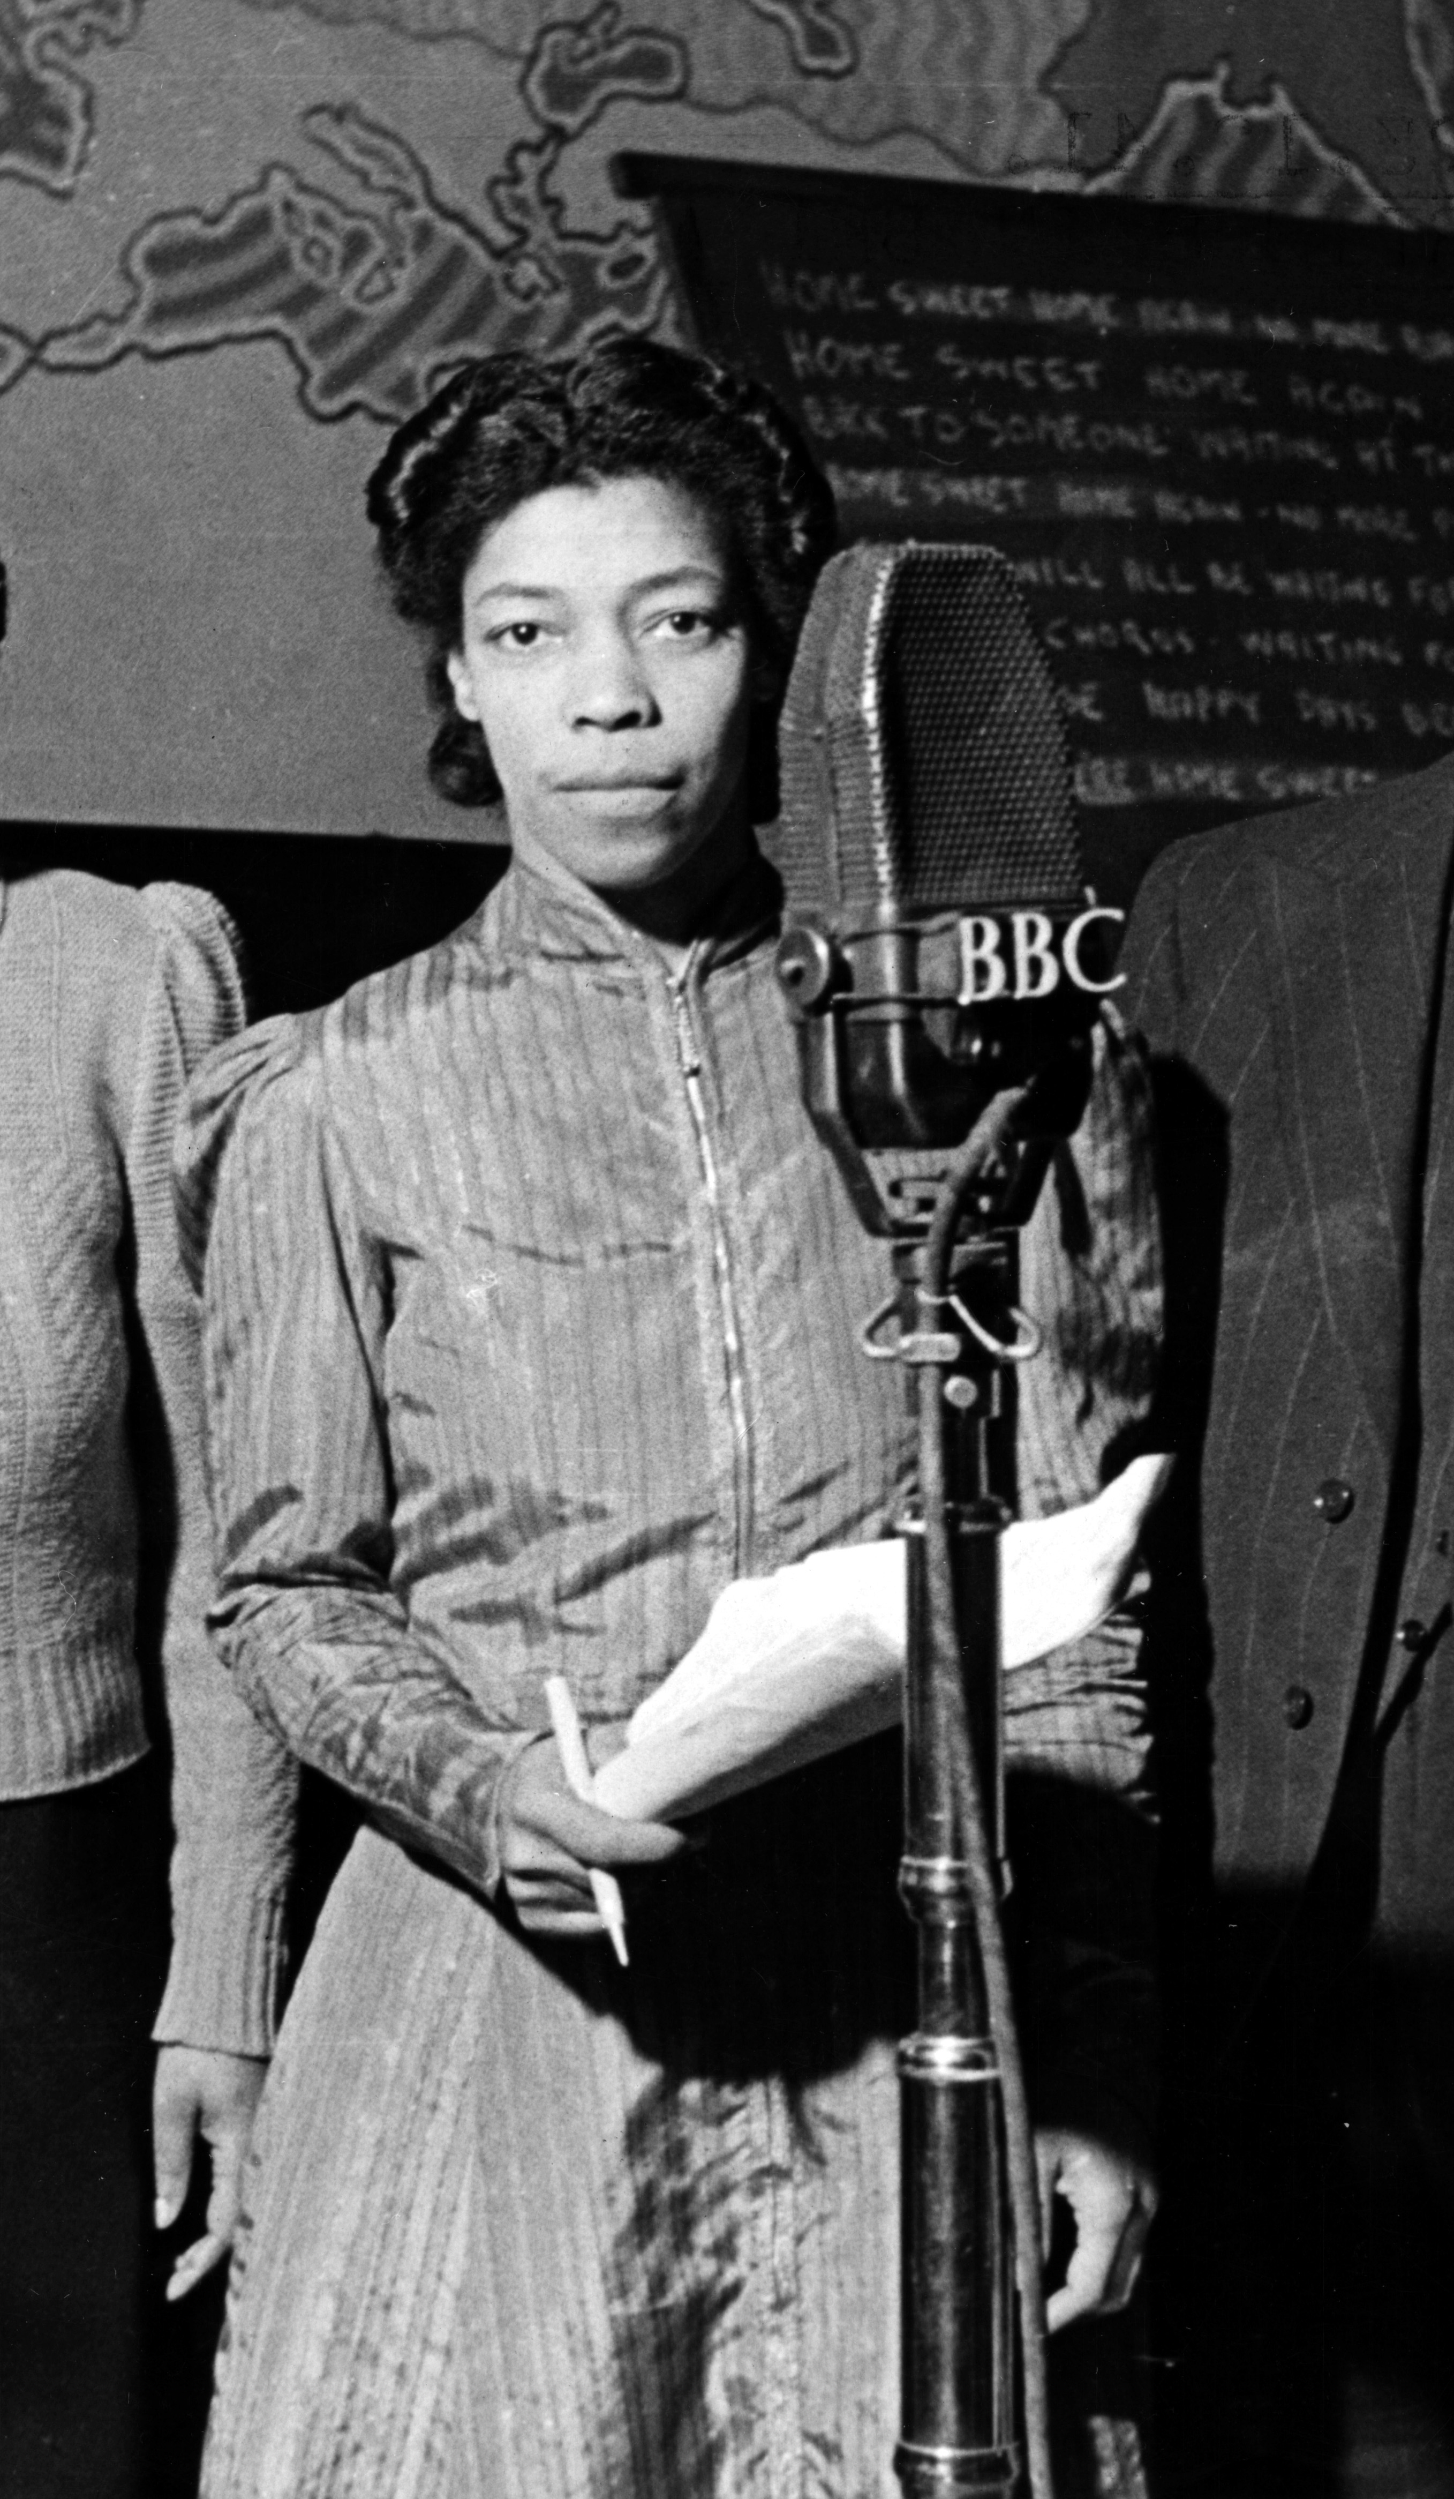
Una Marson
Notes:
Una Marson and the BBC
During the Second World War Una Marson became the BBC’s first black programme maker. She volunteered as an air raid warden in her spare time.
Una arrived in London from Jamaica in 1932. She was secretary to the League of Coloured People and campaigned on black women’s issues such as discrimination in the nursing profession.
In March 1941 Una was appointed as programme assistant on the BBC’s Empire Service. She later became presenter of BBC radio’s “Calling the West Indies” through which she helped many service men and women from the Caribbean stay in touch with their families during the war.
Una was widely respected and counted literary figures such as George Orwell and T. S. Elliot among her BBC colleagues. Her international circle included prominent African Americans, such as writers Langston Hughes and James Weldon Johnson. Una died from a heart attack in Jamaica in 1965.
. After the war, Una continued to work in politics, broadcasting and literature until her premature death in Kingston, Jamaica, from a heart attack, in 1965. In 1998 Delia Jarrett-Macauley published a critically acclaimed biography, The Life of Una Marson 1905-1965, and in 2005 Una was awarded a Southwark Council Blue Plaque, voted by the people of the borough.

Slide 7
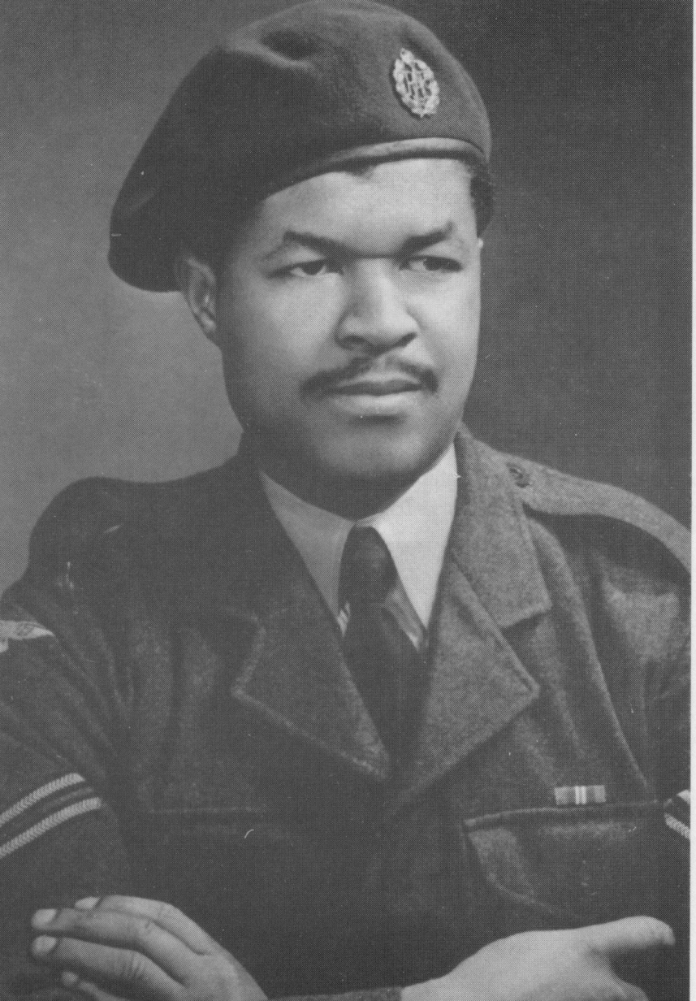
Sam King
Notes:
Sam King MBE was born in Jamaica in 1926. After serving as an RAF aircraft engineer, during the Second World War and until 1947, King sailed to Britain on the Empire Windrush in June 1948. Unlike most of those arriving (including many ex-servicemen), King decided to rejoin the RAF and served until 1952. During that time he and his brother, Wilton became the second Caribbean family to buy a house in Southwark. Having endured racism when he first arrived looking for ‘digs’, he was again to receive the same treatment when he applied for his first mortgage in 1950. He was turned down and told to ‘go back to the colony’. Undeterred he went directly to the home-owner selling the property, who was so appalled by the treatment King received he personally gave him the mortgage. Thus, King owned his first house in Sears Street, Camberwell.
As an ex-serviceman, King was able to find employment in the postal service, working his way up to Postal Executive for the South Eastern district. King married Mavis Kirlew in 1954, at Emmanuel Church in Camberwell. Later in life he become active in politics, joining the Labour Party in the 1970s, getting involved in the Race Committee in the 1980s and becoming a Southwark Councillor, serving Peckham’s Bellenden Ward, in 1982.
King was elected Mayor of Southwark in 1983 in recognition of his community work and his many other community achievements. Sam King was awarded an MBE from the Queen in 1998 in recognition of his work and life. He died in 2016.

Slide 8
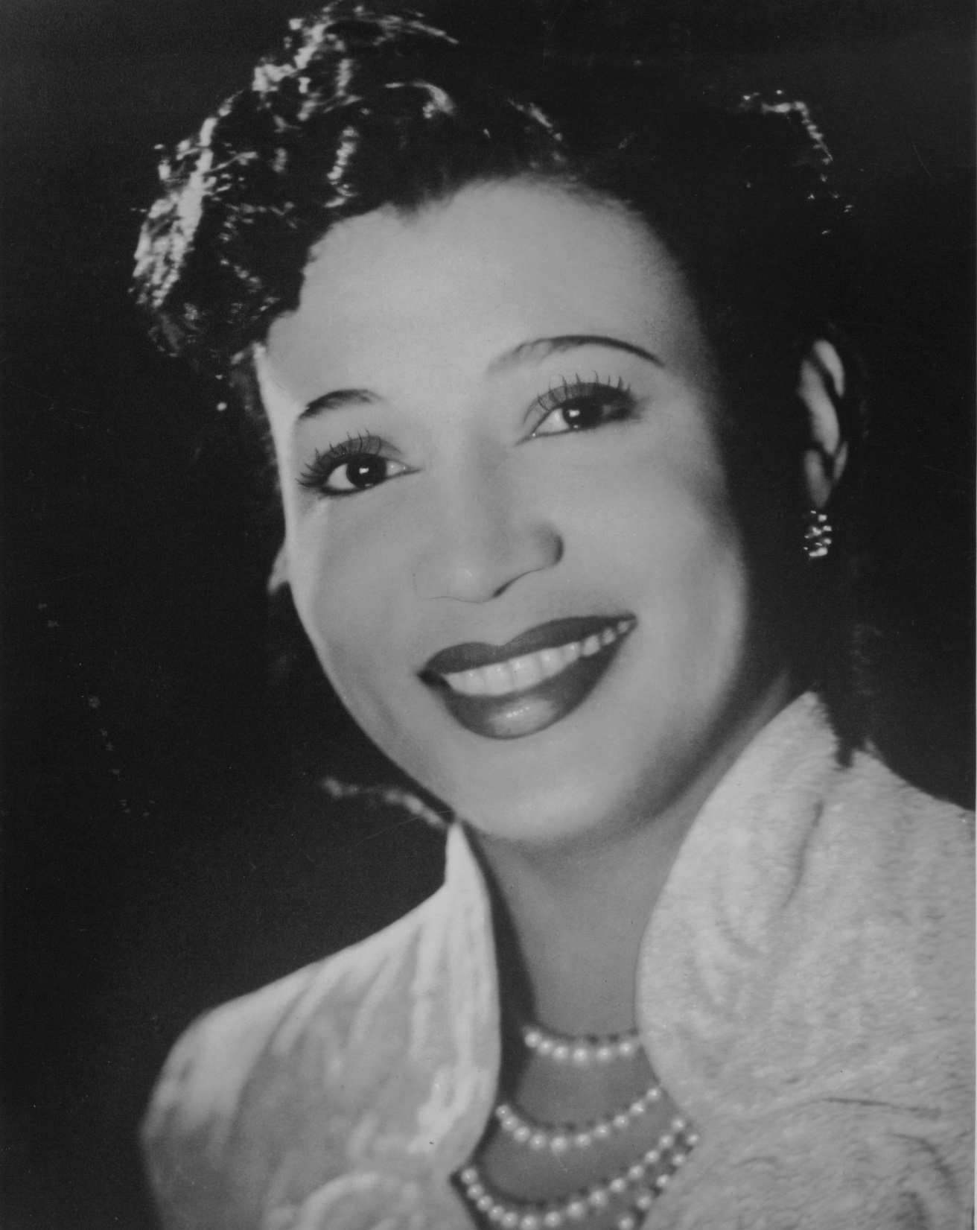
Elisabeth Welch
Notes:
Glamourous American singer Elisabeth Welch settled in London in 1933,. Elisabeth became a big star of West End musicals and BBC radio. At the outbreak of war, the American government advised all expatriates to return home, but Elisabeth decided to stay: “All my friends were here and I didn’t want to leave them.” Throughout the war, Elisabeth supported the war effort by entertaining the troops and war workers in factories. In December 1942 she travelled to Gibraltar to entertain the troops stationed there. She was accompanied by such theatrical greats as Edith Evans and John Gielgud: “We were asked by the War Office to go out to Gibraltar to entertain the troops. Not ENSA, but HM [His Majesty’s] Government itself. I felt very grand.” During their four-week stay the company performed fifty-six shows, including one on board a ship to more than two thousand men, two in the local hospitals, and some on board battleships and aircraft carriers.

Slide 9
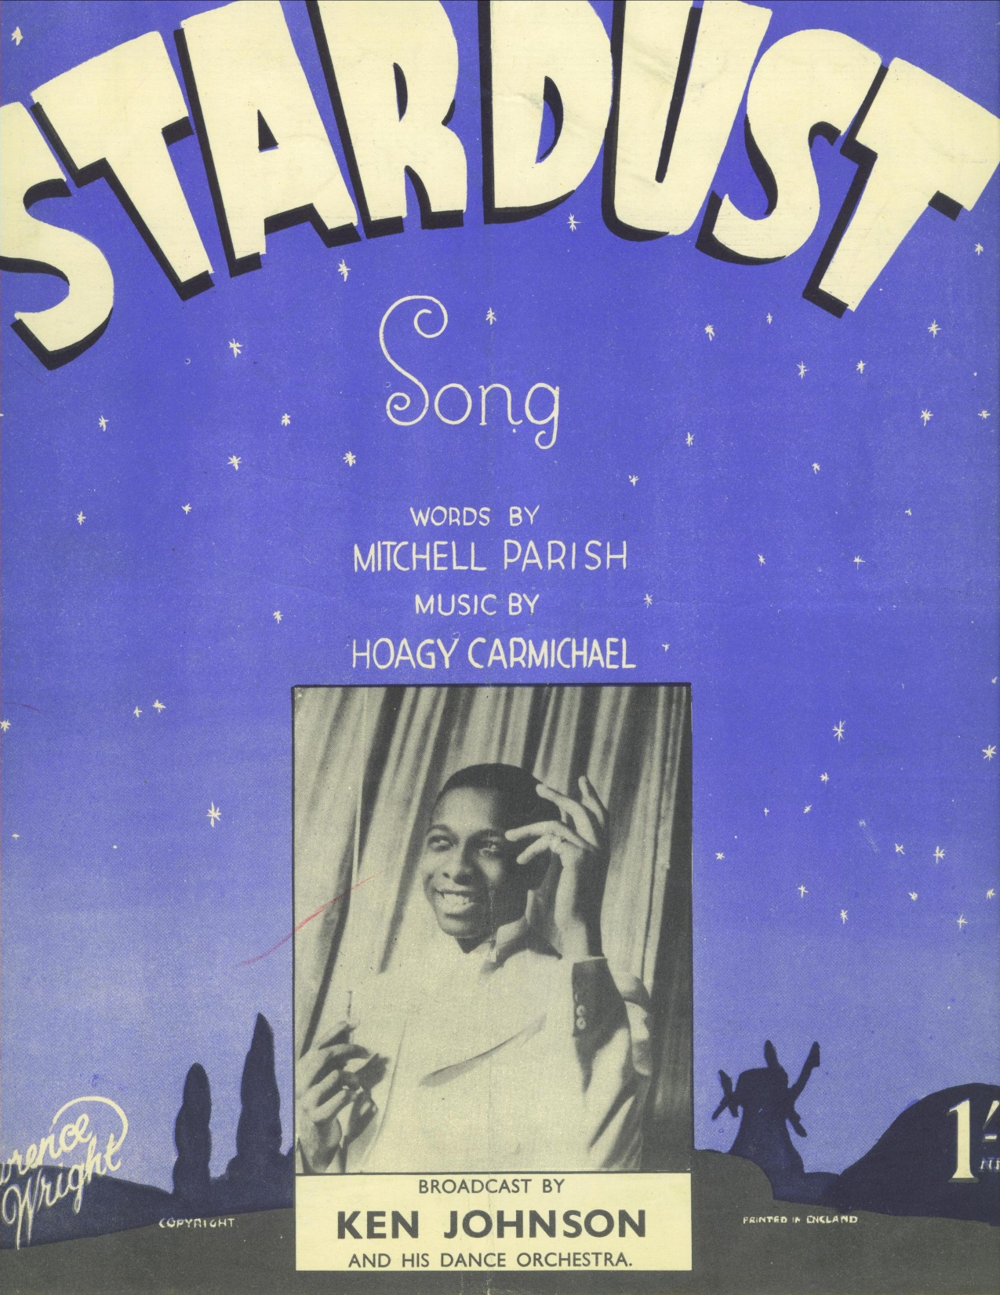
Ken Johnson
Notes:
An entertainer’s story – Ken “Snakehips” Johnson
By 1939, bandleader Ken Johnson and his West Indian Dance Orchestra were already well known. Johnson’s main achievement was to provide a positive image for black musicians in Britain, and show that Britain could produce a bandleader as sensational as Americans like Duke Ellington.
Ken was born in British Guiana in 1914 and was educated at a private school in Marlow, Buckinghamshire. Instead of studying law, he decided swing music was his future and started out as a dancer. He rose to fame in the 1930s with his dance orchestra and enjoyed a long residency at the Café de Paris near Piccadilly.
The Café de Paris was advertised as “London’s safest restaurant”. However during a raid in 1941 two bombs crashed through the roof, onto the dance floor. One exploded in front of the bandstand and immediately killed Ken, who was just twenty six. Around thirty other people also died.

Slide 10
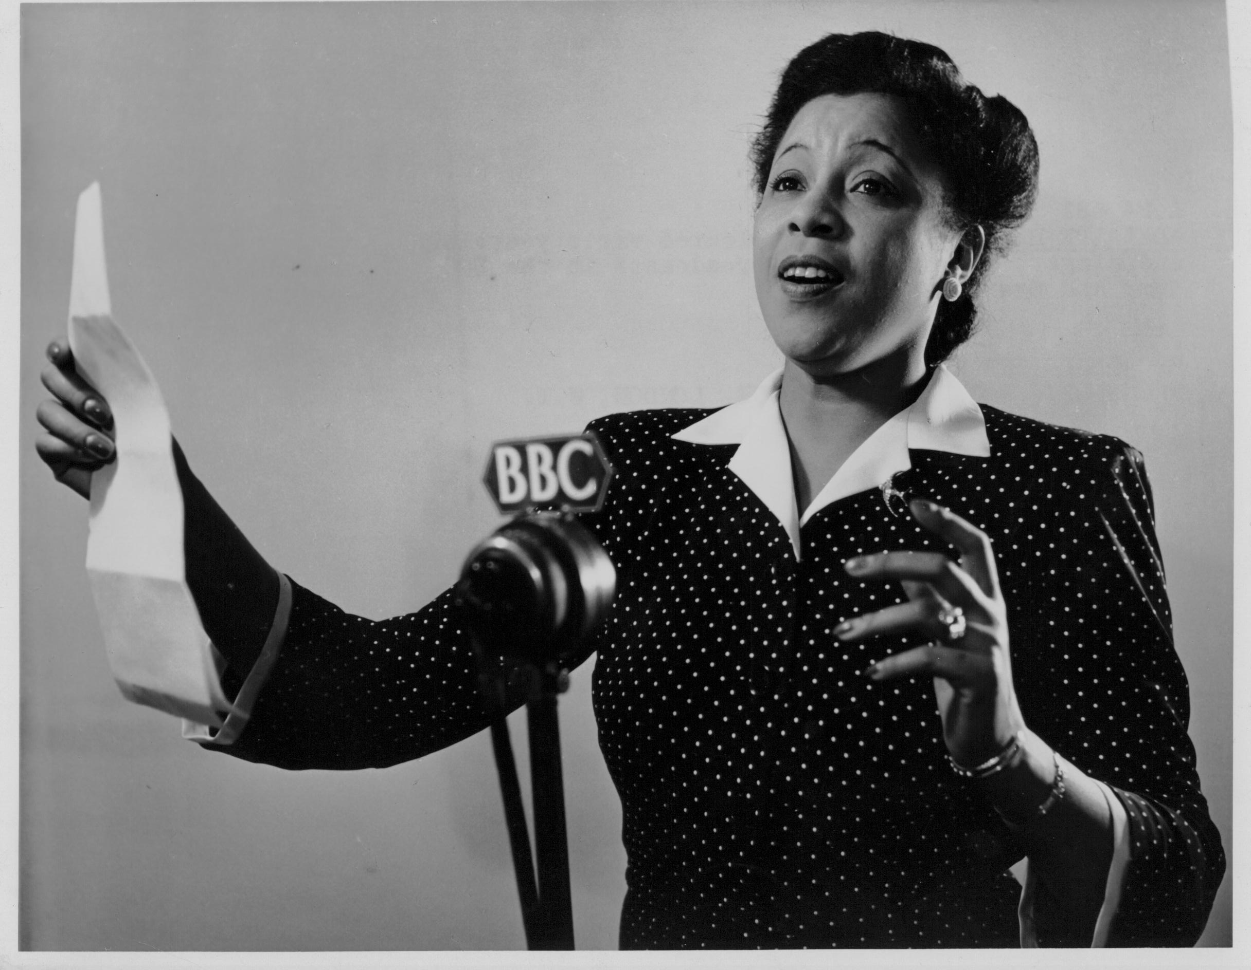
Adelaide Hall
Notes:
An entertainer’s story – Adelaide Hall
Singer Adelaide Hall was one of Britain’s most important morale-boosting stars and reached the mass British public with her broadcasts and tours.
Born in New York, Adelaide moved to London in 1939. An internationally famous jazz performer, she joined the Entertainments National Service Association (ENSA) in 1943. She worked tirelessly for the war effort, performing around the country civilians and the armed forces.
During one of London’s heaviest air raids in 1940 Adelaide was performing at the Lewisham Hippodrome. The air raid siren sounded; “…no one could leave the theatre because it was too dangerous….so we carried on and I managed to get the audience to join in many of the songs”. She continued until 3.45am when the all-clear sounded.
She also entertained people in underground shelters. “We didn’t worry too much about the terrible risks we were taking because we wanted to keep up the morale of the forces and the public”.

Slide 11
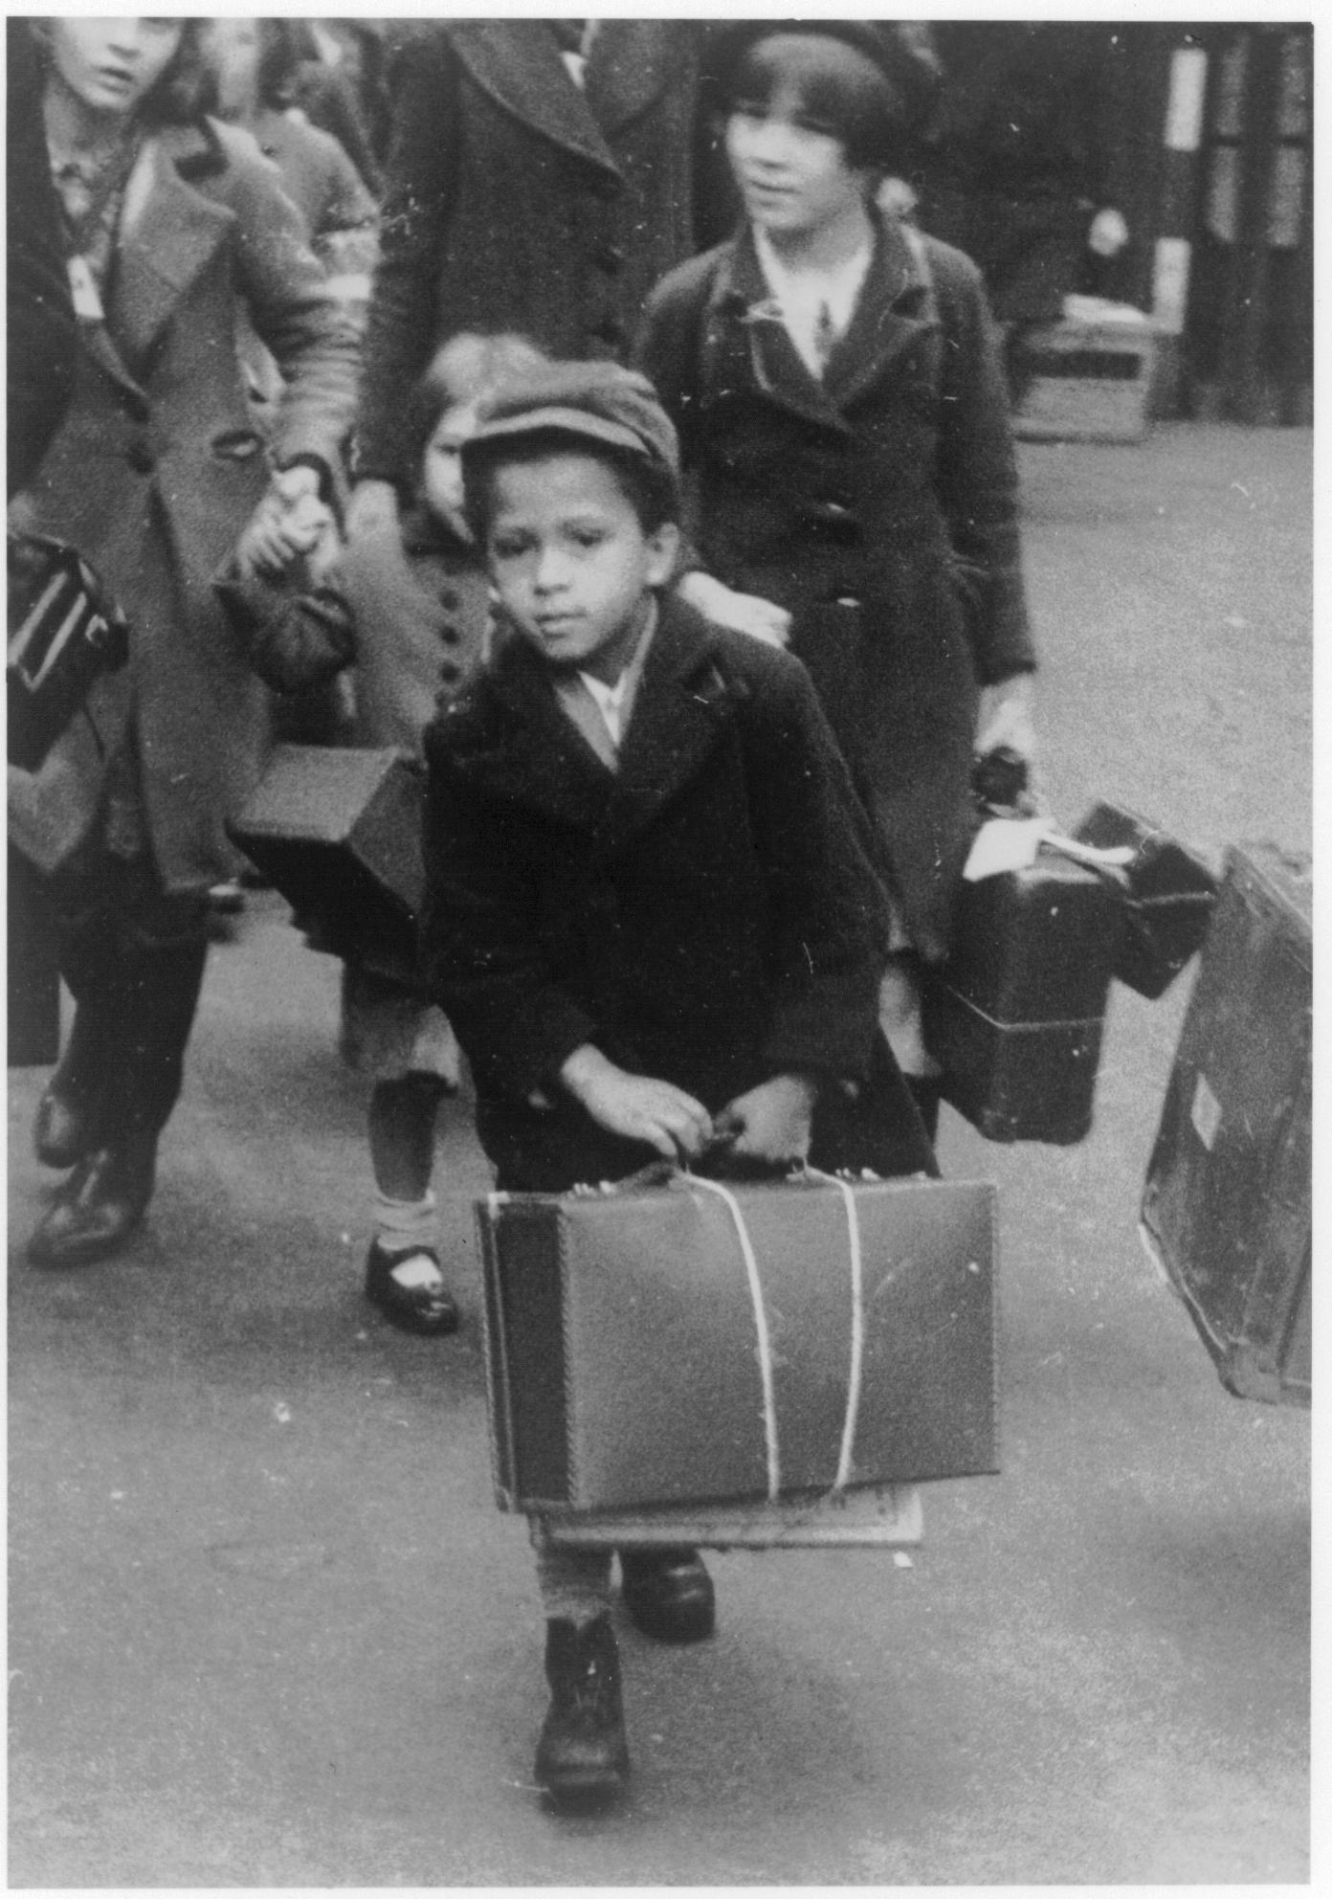
Evacuees
Notes:
Many black children were evacuated from cities to protect them from air raids. They were often sent to country communities with no experience of black people.
Joseph Crozier was ten years old when he was evacuated from Canning Town to Wiltshire: “There was a crowd of us from the East End, but we were the only coloured children…We were taken to the village hall where villagers came and picked the children they wanted, but we were left out. They only picked the white children, except one boy had impetigo….At the end of the day the vicar took us home…”
Not all children were evacuated. Some stayed with their families because they were too young. Kenny Lynch was the youngest of eleven children born to a Barbadian father and English mother. He remembers “we used to go down to these air raid shelters every night, and we were bombed out of about three houses”.

Slide 12
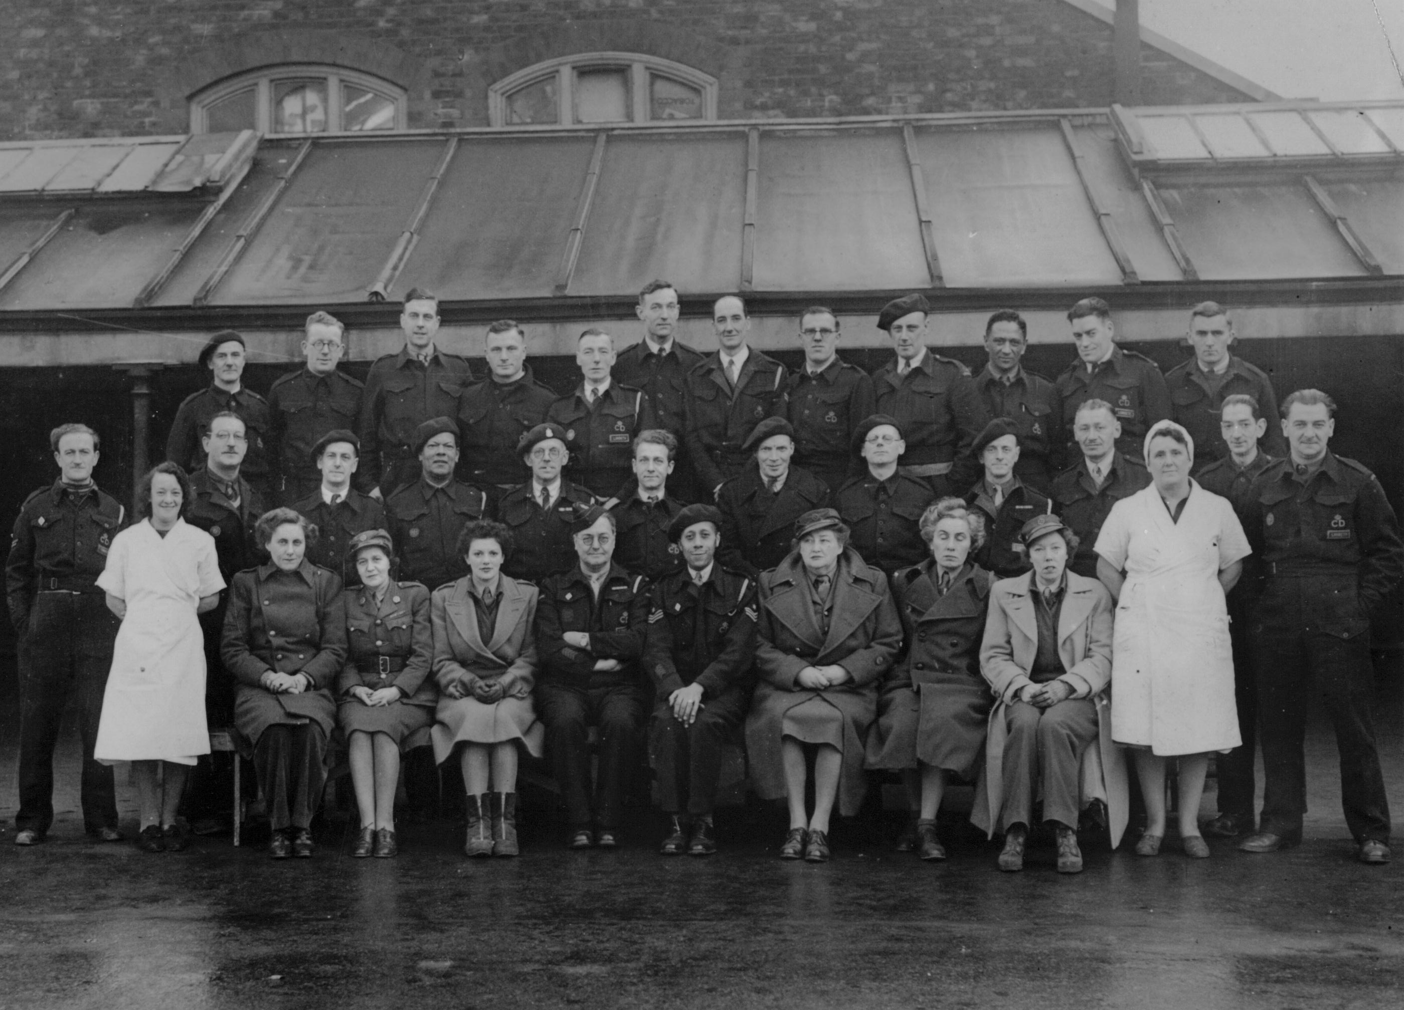
Civilian Defence
Notes:
London was harder hit by German bombing than anywhere else in Britain. The civilians of London played a huge role in protecting their city.
Many civilians contributed to the defence of their city through volunteering as air raid precaution wardens, fire watchers or as members of the Home Guard. The League of Coloured People’s newsletter praised the work of Black ‘front-liners’: “In London especially one is amazed at the numbers of coloured men who have accommodated themselves to the novel circumstances of the war….”
The sustained bombing of London between 7 September 1940 and 10 May 1941 was known as “the blitz”. Over 43 000 civilians were killed and more than a million houses were destroyed or damaged. Unfortunately during this period some black Londoners were evicted or barred from air raid shelters. Some encountered racism and discrimination while looking for new accommodation on being bombed out of their homes.

Slide 13
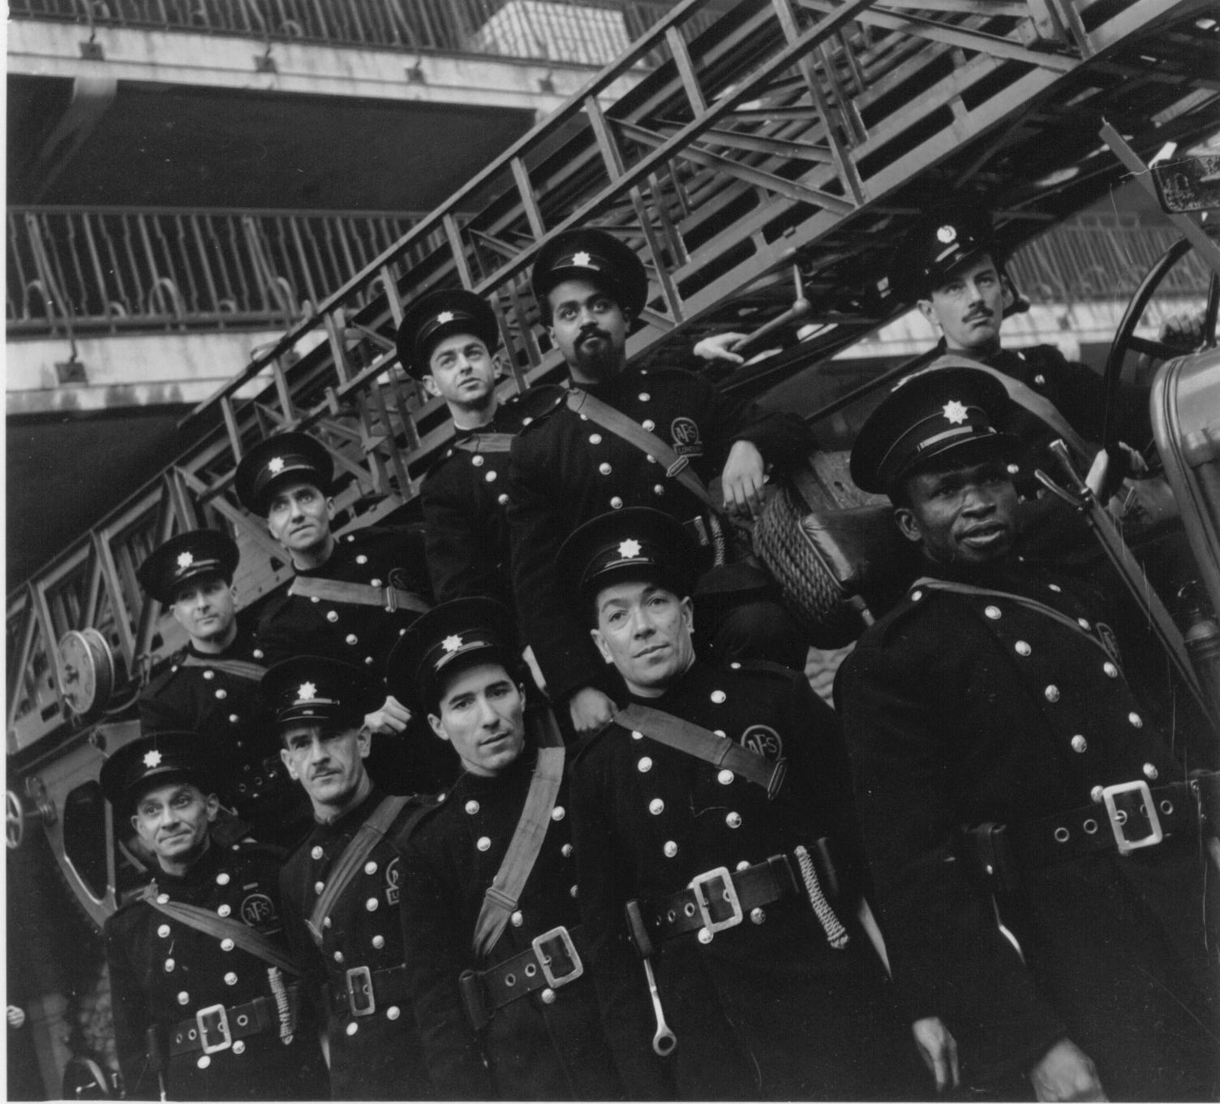
Fire Brigade
Notes:
Photo Credits: Imperial War Museum

Slide 14
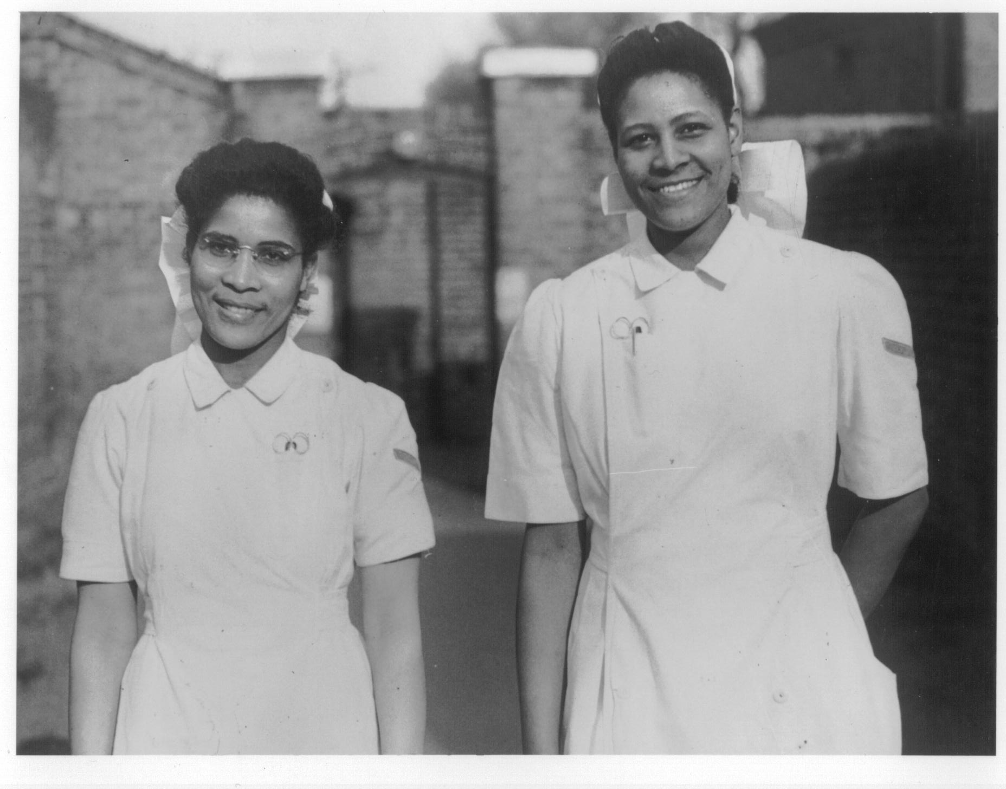
Nurses

Slide 15
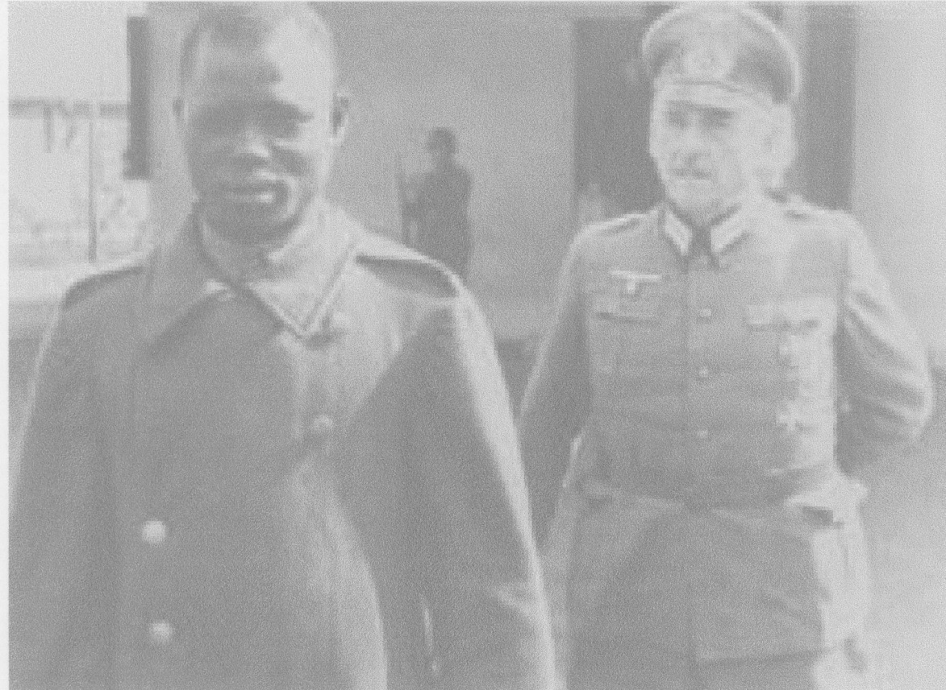
Black prisoner of war in Nazi Germany

Slide 16
Find out more
Credit for quotes and images not otherwise credited go to author Stephen Bourne;
His numerous publications are listed here: https://en.wikipedia.org/wiki/Stephen_Bourne_(writer)
Also see https://www.thehistorypress.co.uk/articles/10-things-you-didn-t-know-about-britain-s-black-community-during-the-world-wars/
Check out The National Archives: https://www.nationalarchives.gov.uk/black-history/
The Imperial War Museum also has useful links to further information here: https://www.iwm.org.uk/research-projects/whose-remembrance/resources
Southwark Archives, part of the Southwark Heritage Service, can also be contacted here: LHLibrary@southwark.gov.uk

