Slide 1
Home front Southwark
South London in the Second World War: An Introduction and Source Guide
Compiled by Dr Patricia Dark Archivist, Southwark Council
Notes:
This guide aims to provide an introduction to the Second World War home front, give context to primary source and other material, and to provide a list of further sources. It’s aimed at people guiding and directing students – teachers and parents – but older students (KS3 and up) may also find it useful. While the author drafted it for use as a teacher’s guide, the tables and images in this guide can also be used as student handouts.
Words that may be unfamiliar are printed in bold the first time they appear; their definitions appear immediately after, either in brackets or in the main text.
Southwark Council and the author make this guide freely available for non-commercial educational use by students, carers, and teachers: it may not be used for any commercial purpose, including for-pay tutoring. The images in this document are intended as reference material for students. Any other use of these images requires permission and/or copyright clearance from Southwark Council, for which you are likely to be charged.
Southwark Council reserves copyright and the author reserves her moral rights. References for images and other archival and museum material are included in captions and text: these allow you to find the material for yourself. Please do not remove or alter these references.
This work presents material from the archived site of the BBC’s WW2 People’s War project. WW2 People's War is an online archive of wartime memories contributed by members of the public and gathered by the BBC. The archive can be found at www.bbc.co.uk/ww2peopleswar.
This work also presents links to video streams of archival films from the collections of the Imperial War Museums. Any commercial use of these films requires the permission of the Imperial War Museums: please contact IWM Film for more information.
The author reasonably believes that all use of material in third-party copyright falls under the educational exemption of the Copyright Designs and Patents Act 1988.
If you:
have any questions, comments, or corrections to this document,
would like more information about the material presented here,
have information or questions about copyright,
would like to use an image presented here,
are the copyright holder of an image presented here,
would like more information about our collections or the heritage services, or
would like to donate material to us
please email local.history.library@southwark.gov.uk.

Slide 2
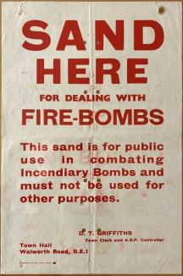
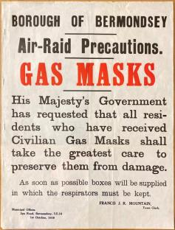
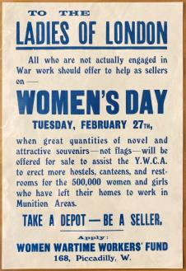
What is the home front?
Public information posters: Southwark Archives, POSTERS 940.544
Notes:
The home front refers to the activities of civilians (people who are not in the military) in a nation during wartime. The Second World War was a total war: one where all the resources of a society are brought to bear on the war effort, civilian needs are much less important than waging war, and where civilian resources and infrastructure (the basic things that make a place liveable, like transport, water, and power) are considered legitimate targets. In a total war, in short, the line between civilian and combatant becomes more or less blurred.
Even for children, the start of the Second World War brought massive upheaval to daily life. Civilians on the home front faced the danger of German air raids, the responsibilities of civil defence, the restrictions of rationing, and the upheaval of evacuation. This presentation uses original material from Southwark’s collections, as well as other archives and museums, to introduce students to the realities of life on the home front.

Slide 3
Home front Glossary
ARP Air raid precautions
CD Civil defence
Kriegsmarine (German) navy
Luftwaffe (German) air force
LA Local Authority
LCC London County Council
MB Metropolitan Borough
S&R Search and Rescue
Notes:
You may not be familiar with some of the words and abbreviations connected to the Second World War home front. This glossary (list of terms and definitions) may help. If you find other words you don’t know, add them below.

Slide 4
Air raids
Notes:
German forces invaded northern France, the Netherlands, and Belgium on 10 May 1040. By the end of June, after the evacuation of more than 300,000 Allied soldiers from Dunkirk in late May, all three countries had surrendered. The focus of the war shifted to the United Kingdom. Almost all attacks on the UK came from the air.
Air raids on the British home front came in five phases: they are shown as a timeline on page 5. British historians refer to the first, from July to October of 1940, as the Battle of Britain. German air forces targeted coastal shipping, ports, and naval centres like Portsmouth. Their original aim was to pressure the British into negotiating a peace treaty, which would allow Germans to turn their attention to the Soviet Union.
From mid-July 1940, raids increasingly targeted RAF facilities, to gain air superiority before Operation Sea Lion (the planned invasion of the UK) began. However, as Luftwaffe losses mounted, and with air superiority still firmly in British hands, Hitler postponed Operation Sea Lion indefinitely in mid-September 1940.
British historians generally refer to the next phase of the home front war, which began on 7 September 1940, as “the Blitz”. The early part of the Blitz involved daylight bombing raids, including a major one on London on 15 September, but these ended in October due to the effectiveness of RAF counterattacks; from then until May 1941, when Hitler turned his attention to the invasion of the Soviet Union, German raids occurred at night.
The main purpose of the Blitz was to reduce British capacity to wage war by destroying industrial, naval, and transport facilities. However, the Blitz also reflects Hitler’s belief in the value of bombing as a weapon of terror. Sapping the morale and will to fight of British civilians was a secondary reason for the Blitz that became more and more important as it continued. Sapping morale was the main reason for the “Baedecker Blitz” of 1942 and the “Baby Blitz” of the winter 1943/4.
The Baedecker Blitz – named for a popular German guidebook publisher whose works provided targets – specifically targeted cities with cultural and historic, rather than strategic, value. The largest of these raids, in April and May 1942, targeted Bath, Canterbury, Exeter, Norwich, and York. Usually, a Baedecker raid was a direct reprisal for a raid on a German city, beginning with the northern port of Lübeck in March 1942. The Baedecker raids produced few gains for the Germans at a heavy cost in personnel and aircraft.
From the end of 1943, increasing Allied air superiority meant that German cities faced devastating raids around the clock – particularly Berlin. In January 1944, Hitler ordered retaliatory raids, known as Operation Steinbock or the Baby Blitz. London and surrounding areas were the primary targets, but a few raids targeted other ports. The Baby Blitz had a number of aims: retaliation, raising morale at home, lowering British civilian morale, and (eventually) disrupting preparations for the Allied invasion of Normandy. However, the Baby Blitz was another costly failure: its losses in personnel and aircraft meant the Luftwaffe could not resist the D-Day invasion. It was the last strategic bomber offensive the Germans mounted.
German Armament Minister Albert Speer promised retribution for the mass bombing of German cities using a “secret weapon” as early as September 1943. Use of these “V weapons” was the final phase of the home front’s war. The V1 was an early cruise missile, launched from sites in northern France and the Netherlands; attacks began a week after D-Day. The V2 was the first long-range guided ballistic missile, and one of the earliest rockets: unlike the V1, it was usually launched from mobile sites. Attacks against British targets began in September 1944. This final phase ended in March 1945, as the Allies liberated all the continental areas capable of acting as launch sites against the UK.
The V weapon raids had a significant effect on home front life. In less than 3 months, V1s damaged or destroyed more than 1 million buildings and caused over 22,000 casualties. V2s had an outsized psychological impact – unlike the V1, they travelled faster than the speed of sound, so gave civilians no warning to take cover before impact.
Cities and towns all over the country experienced German air raids, which could – and did – inflict heavy casualties and devastate city centres. The Coventry Blitz of 14-15 November 1940 or the Three Nights’ Blitz on Swansea in mid-February 1941 are good examples. Other cities – notably ports like Bristol or northern industrial towns – were raided repeatedly.
London, however, was the city hardest hit by German air raids, in terms of number of raids, length of time under attack, and number of casualties. The scale of attack on the capital was altogether different – between September and November 1940, there were only 2 24-hour periods where London did not see enemy air attacks: over 77 consecutive nights, 76 saw at least one air raid. Fully 60% of the 2,000,000 houses destroyed in the Blitz were in London – a third of the capital’s buildings were destroyed.
London was a target for a number of reasons. As the capital, it was the heart of the British Empire’s war effort – destroying important public buildings or killing government officials had a good chance of ruining the country’s ability to wage war. London also had a large number of strategic targets – transit hubs like railway stations and docks, wharves and warehouses, and factories: destroying these crippled the war effort. Finally, there was significant propaganda value in inflicting massive, obvious damage on the nation’s capital – if civilians decided that the authorities couldn’t protect them, the suffering might prompt them to give up on total war.
Southwark in particular saw heavy air raid damage: nearly 2,000 people died and thousands of homes were destroyed in the three metropolitan boroughs that make up the London Borough of Southwark. In large part, this was because it contained a large number of high-value targets. The docks, wharves, and warehouses in London Bridge, Bermondsey, and Rotherhithe dealt with a sizable fraction of the nation’s imports of food and wood (both vital for the war effort). The rail stations at London Bridge, Waterloo, and the Bricklayers’ Arms and the road junction at the Elephant and Castle were vital to the transport of troops and freight around the country and to the front. Bankside, Bermondsey, Camberwell, Peckham, and Walworth also featured factories producing war material.
Southwark – particularly the more southern areas of the modern borough – was also on the way to other targets like the city of London: in some cases, damaged enemy bombers attempting to dump their payload and escape caused catastrophic damage in areas that were not formal targets.

Slide 5
Jun-Sep 1940
The Battle of Britain:
Laying ground for peace negotiation or invasion
Sep 1940-May 1941
The Blitz:
Demoralise people, destroy war industries
Apr 1942-Jan 1944
The “Baedecker Blitz”:
Targeted attacks on cultural sites
Jan-May 1944
“Baby Blitz”:
Retaliation for raids against Germany
Jun 1944-Mar 1945
V Weapons:
Long-range artillery attacks
Notes:
Air raids on the British home front came in five distinct phases. British historians refer to the first, from July to October of 1940, as the Battle of Britain. German air forces targeted coastal shipping, ports, and naval centres like Portsmouth. Their original aim was to pressure the British into negotiating a peace treaty, which would allow Germans to turn their attention to the Soviet Union.
From mid-July 1940, raids increasingly targeted RAF facilities, to gain air superiority before Operation Sea Lion, the planned invasion of the UK, began. However, as Luftwaffe losses mounted, and with air superiority still firmly in British hands, Hitler postponed Operation Sea Lion indefinitely in mid-September 1940.
British historians generally refer to the next phase of the home front war, which began on 7 September 1940, as “the Blitz”. The early part of the Blitz involved daylight bombing raids, including a major one on London on 15 September, but these ended in October due to the effectiveness of RAF counterattacks; from then until May 1941, when Hitler turned his attention to the invasion of the Soviet Union, German raids occurred at night.
The main purpose of the Blitz was to reduce British capacity to wage war by destroying troop transport – road, rail, and air facilities – naval, and industrial capacity. However, a secondary purpose – that became more important over time – was to sap the British people’s morale and will to fight; this reflects Hitler’s personal views on the value of bombing as a weapon of terror.
The “Baedecker Blitz” of 1942 and the “Baby Blitz” of the winter 1943/4 show these views in action. The Baedecker Blitz – named for a popular guidebook publisher whose works provided targets – specifically targeted cities with cultural and historic, not strategic, value. The largest of these raids, in April and May 1942, targeted Bath, Canterbury, Exeter, Norwich, and York. Usually, a Baedecker raid was a direct reprisal for a raid on a German city, beginning with the northern port of Lübeck in March 1942.
The Baedecker raids produced few gains for the Germans at a heavy cost in personnel and aircraft. Moreover, from the end of 1943, increasing Allied air superiority meant that German cities faced devastating raids around the clock – particularly Berlin. In January 1944, Hitler ordered retaliatory raids, known as Operation Steinbock or the Baby Blitz. London and surrounding areas were the primary targets, but a few raids targeted other ports. The Baby Blitz had a number of aims: retaliation, raising morale at home, lowering British civilian morale, and – at the end – disrupting preparations for the Allied invasion of Normandy. However, the Baby Blitz was another costly failure: losses sustained in it meant the Luftwaffe could not resist the D-Day invasion. It was the last strategic bomber offensive the Germans mounted.
German Armament Minister Albert Speer promised retribution for the mass bombing of German cities using a “secret weapon” as early as September 1943. Use of these “V weapons” was the final phase of the home front’s war. The V1 was an early cruise missile, launched from sites in northern France and the Netherlands; attacks began a week after D-Day. The V2 was the first long-range guided ballistic missile, and one of the earliest rockets: unlike the V1, it was usually launched from mobile sites. Attacks against British targets began in September 1944. This final phase ended in March 1945, as the Allies liberated all the continental areas capable of acting as launch sites against the UK.
The V weapon raids had a significant effect on home front life. In less than 3 months, V1s damaged or destroyed more than 1 million buildings and caused over 22,000 casualties. V2s had an outsized psychological impact – unlike the V1, they travelled faster than the speed of sound, and gave no warning to civilians before impact.

Slide 6
Civil Defence
Notes:
Air raids were the offensive half of the home front war – bringing the war to the enemy’s civilians. Civil defence was the home front’s defensive war – protecting friendly civilians from hostile action. The experience of First World War air raids made clear that civil defence provision needed to be government-organised, comprehensive, and in place from the start of the war; legislation and cabinet decisions in the late 1930s began putting these provisions in place.
Planning for the worst
The Home Office created the Air Raid Precautions department as early as 1935, and local authorities were allowed to begin planning civil defence. The Air Raid Wardens’ Service was created two years later, to enroll and train volunteers in civil defence. However, many local authorities – particularly in working-class areas – were unwilling to begin civil defence work, seeing it as a step toward an unwelcome war. However, as war loomed ever closer, the situation – and the law – changed.
The Air Raid Precautions Act 1937 came into force in April 1938, and kick-started civil defence by forcing local authorities, led by county councils, to develop measures to protect lives and property from air raids and ensure adequate fire-fighting capacity. In compensation, it allowed councils borrowing and compulsory purchase powers.
1939 brought two more developments. The first was the creation of the Ministry of Home Security, with the Home Secretary as portfolio-holder, to take responsibility and provide oversight for civil defence. Its guidance circulars to local authorities, businesses, and householder set standards for civil defence. The ministry also had direct oversight of county council civil defence schemes and a supervisory role to borough council civil defence work.
The second was the Civil Defence Act 1939, which gave local authorities additional powers to take over transport and buildings for civil defence, to provide grants or free shelters to individual householders, and made businesses responsible for providing shelters and imposing blackout. From early 1941, civil defence included fire watchers and fire guards, who had a round-the-clock mission to ensure that incendiary bombs didn’t burn down unattended buildings like factories or businesses.
Civil defence functions
There were two kinds of civil defence functions: air raid precautions and emergency response: page 7 shows them in chart form. The main air raid precautions were blackout, shelters, and gas masks.
Blackout was the practice of dramatically reducing the amount of externally-visible light, by covering doors and windows, turning off or dimming street lighting, and dimming or covering headlights; this meant that enemy bombers had fewer waymarks to navigate by, and friendly shipping was not silhouetted by city lights on the coast.
From 1938, councils also provided air raid shelters and gas masks: either directly, by building public shelters or giving individual householders domestic shelters, or via grants to organisations and householders to build their own. Gas masks, while distributed and required to be carried at all times, were never used: neither the Allies nor the Axis wanted to provoke reprisal by first use of poison gas.
Emergency response included the immediate aftermath of an incident – rescue and first aid – but also providing emergency food, shelter, and clothing to local people whose homes had been destroyed.
Civil defence structure
ARP had a hierarchical structure: lower levels reported incidents to higher levels, who coordinated the response and issued orders down the chain. This structure is shown in chart form on page 8. The country was split into regions – region 5 covered London and the Home Counties, with regional headquarters in the Geological Museum in South Kensington.
Regions were further split into groups, with their own headquarters: in London the ARP groups were based on metropolitan boroughs, which also had their own central control. The modern borough of Southwark was split between groups 4 and 5, as shown on the map on page 8. Group 4 covered the metropolitan boroughs of Bermondsey, Deptford, Greenwich, Lewisham, and Woolwich, and group 5 covered the metropolitan boroughs of Battersea, Camberwell, Lambeth, Southwark, and Wandsworth.
Metropolitan boroughs were further split into sectors, usually based on electoral wards; each sector control would have responsibility for one or more wardens posts. Warden posts were the most local units, covering a walkable distance of a few streets – in London there were usually 10 posts per square mile. They provided a base for wardens to mount patrols, and a place for them to rest between patrols or raids.
The Air Raid Precautions Act demanded that local authorities cooperate with each other and provide mutual aid for air raid defence and response. This included both vertically between different levels of authority, like the London County Council and the metropolitan boroughs, but also horizontally between metropolitan boroughs. Memoirs in Southwark Archives make it clear that CD volunteers could be – and were – sent around the country in response to need. Equally, provincial firefighters and CD personnel might find themselves taking charge of an incident in Southwark.
County councils like the London County Council were responsible for fire and ambulance services, heavy rescue and clearance, removal of the dead, civilian evacuation, provision of welfare and rest centres, and emergency feeding – as well as their usual responsibilities for sewers, hospitals, schools, and parks. Metropolitan Boroughs were responsible for provision of public shelters, organising wardens, and providing first aid and light rescue and clearance – although, in practice, they also provided some welfare services and feeding.
ARP duties
When raids weren’t active, wardens fitted, issued, and replaced gas masks, assisted bombed-out civilians, provided training, and enforced the blackout. During an air raid, local control sounded the alarm, which was the signal for wardens to assist civilians into the nearest shelter; when this was done, they watched the area for falling bombs; if a bomb fell, they alerted control and their post.
After a bomb exploded, a warden would arrive as quickly as possible to assess the situation; after contacting their post to relay information, they managed the first response and entry to the scene, provided first aid for minor injuries, and put out small fires. The post alerted Control, which would coordinate and allocate resources. These included first aid and ambulance units, as well as specialists: light and heavy rescue crews to shore up damaged buildings and search for survivors, professional and auxiliary firefighters to extinguish fires, police, staff from London Transport or one of the railway companies, the General Post Office (who had responsibility for telephone and telegraph lines), the Metropolitan Water Board, or one of the 5 electric and 3 gas companies serving Southwark. The chart on page 13 represents this response graphically.
Voluntary groups like the British Red Cross, the Salvation Army, St John’s Ambulance, and the Women’s Voluntary Service (WVS) assisted with emergency response – they found emergency housing, took messages, washed salvaged clothes, and provided food and hot drinks for victims and responders.
Young people also played important roles in civil defence. Boy Scouts acted as messengers when other communication methods failed. Girl Guides assisted after raids, providing first aid and help with salvage; they also staffed rest centres, canteens, and communal shelters, providing hot food, entertainment, childcare, and a helping hand.
Air raid shelters
The most important civil defence responsibility of metropolitan boroughs was to provide air-raid shelters. For many councils, this led to a focus on domestic shelters such as Anderson shelters: flexible steel sheets that a householder bolted together into a domed shelter, and usually buried in the garden. Anderson shelters could hold up to 6 people, but they had significant drawbacks: they were uncomfortable in cold and wet weather, and did nothing to block out the noise of bombing. Moreover, many homes – like those in much of Southwark – did not have gardens. In these areas, councils built small brick and concrete surface shelters. Another alternative was the Morrison shelter; introduced in March 1941, it was essentially a steel cage in which two adults and one or two small children could sleep. During the day, it could act as a table; during a raid, it offered more comfortable against bomb splinters and structural collapse.
For communal use, councils originally built larger versions of the domestic surface, or identified and reinforced basements in large buildings like factories or underpasses like railway arches. However, none of these offered appreciable shelter from direct hits. Where these shelters were hit directly, like the shelter at Douglas Buildings, Marshalsea Road in 1941 or the railway arch shelters at Druid Street in 1940 and Stainer Street in 1944 – many people were killed and injured.
Many people in densely populated areas like Southwark preferred deep shelters like Tube stations; government officials, however, were wary for a number of reasons, including cost, lack of hygiene facilities, the difficulty of rescuing mass casualties at depth, and the possibility that vital war workers would simply refuse to leave the safety of deep shelters.
Other commentators, notably the eminent biologist JBS Haldane, pointed out the lessons of the Spanish Civil War taught about the physical and psychological benefit of deep shelters. Eventually mounting public pressure opened up Tube stations as shelters on a nightly basis in late September 1940. A cave system in Chislehurst eventually became an underground city of up to 15,000 people, with electric lights, a canteen, a chapel, even a cinema and a police station: busses and trains carried people to and from the East End every day.
The metropolitan borough of Southwark, the most densely populated authority in the country, innovated: the 1890 realignment of the Northern Line of the Tube left several hundred meters of disused Tube tunnel, running down Borough High Street from the river to Borough station, that the borough into a deep-level shelter at half the cost of a new build. This shelter had room for 14,000 people every night, as well as safe storage for the borough’s treasures: you can see press cuttings about the shelter on page X. There was just one problem: locals complained that people travelling from across London were taking up places in a shelter meant for them.

Slide 7
Civil defence: LA responsibilities
Emergency response:
Defence provision:
Mutual aid to other LAs
Housing
Blackout provision and enforcement
Food
Air raid shelters
Clothing
Medical aid
Gas masks

Slide 8
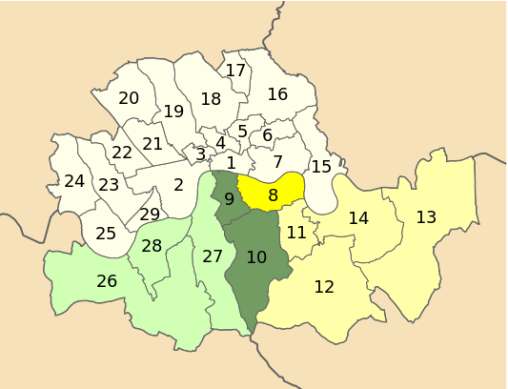
ARP Region 5: Groups 4 (yellow) and 5 (green)
Map adapted by Patricia Dark from from Wikipedia contributor Mirrorme22
Region 5 Command
Group control
MB control
Sector control
Warden post
ARP reporting hierarchy
Notes:
Map adapted by Patricia Dark from Wikipedia contributor Mirrorme22 - Own work, CC BY-SA 4.0, https://commons.wikimedia.org/w/index.php?curid=42979665

Slide 9
Incident
Warden
Post
Utils
Rescue
First Aid
Control

Slide 10
Evacuation
Notes:
By the 1938 Munich Crisis, it was clear that large parts of the country, and millions of people, would be in the total war’s firing line. The question then was how best to protect irreplaceable treasures, vital services, and the most vulnerable people in those areas. The answer was evacuation: moving items, organisations, and people from higher-risk areas (large cities, ports, and coastal towns) to lower-risk areas in rural areas away from the coast.
In May 1938, Sir John Anderson convened the Anderson Committee to review the relative risk of various parts of the country, and to plan for mass evacuation; railway staff, police, and educators gave input. The Committee’s findings divided the country into three roughly equal groups: unsafe evacuation areas, neutral areas, and relatively safer reception areas.
Many museums began moving their most valuable and fragile collections in mid-late August 1939, just before the war began. The British Museum and the Tate moved some items into disused Tube tunnels at Aldwych and Piccadilly. However, most of these collections moved to reception areas. The National Library of Wales housed some of the British Library’s books, while the National Gallery’s treasures found shelter in the disused slate mine at Manod, near Blaenau Ffestiniog, in north central Wales.
Staff of organisations vital to the war efforts also moved to reception areas. For instance, the BBC moved some programming production to Bristol and Bedford; Wood Norton Hall, near Evesham, became an emergency broadcasting centre and workplace for its senior staff. The Post Office similarly moved senior staff to Harrogate. The London, Midland, and Scottish Railway began moving over 3,000 staff to The Grove, near Rickmansworth, Hertfordshire, on 1 September 1939, and completed it within 3 days. Some civil servants moved to empty educational buildings near a newly-built blastproof bunker in Dollis Hill, north London. Some 23,000 others evacuated to empty hotels: the Ministry of Agriculture nearly took over Colwyn Bay in north Wales.
However, the most dramatic evacuation was that of civilians, especially vulnerable ones. Obviously, those with enough money could simply evacuate themselves or their children – over the course of the war, some 2,000,000 adults self-evacuated to reception areas or overseas. By 1941, some 14,000 children had been privately evacuated to the USA or Commonwealth countries.
Many more people could not. The government’s response to this problem, Operation Pied Piper, combined the work of the Anderson Committee and the London County Council. It aimed to move children, pregnant women, and people with disabilities from evacuation areas to reception areas. In reception areas, they would be housed in residential camps, stately homes, or with locals. From early 1939, local authorities in reception areas were drawing up lists of available accommodation.
The scheme was voluntary for evacuation areas; a lack of reception area volunteers meant that local authorities could force people in reception areas to house evacuees. For the first evacuee child, billetors received 10 shillings 6 pence (£26) for the first evacuee they housed, and 8 shillings 6 pence (£17) for each additional evacuee. Only children under 5 were evacuated with their mother or another carer: older children were evacuated in school groups with their teachers.
The largest mass migration in British history began on 31 August, 1939; over the first three days, more than 675,000 children in school groups, more than 400,000 mothers and toddlers, and 3,000 pregnant women moved. London alone had more than 1,500 assembly points – mostly schools – and evacuation trains ran every nine minutes for nine hours. Children were allowed to bring change of underclothes, socks, and shoes, night clothes, a towel and facecloth, a comb and toothbrush, soap, and food.
The sheer complexity of the operation meant that parents could not accompany their children, or even know where they were going. An army of volunteers, including Women’s Voluntary Service personnel and Girl Guides, helped keep groups fed, guided them to their final destinations, and assisted with finding billets.
While nearly half the children in evacuation areas left in September 1939, six months of stalemate during the Phoney War and profound homesickness meant that almost half of the evacuees had returned home by Christmas. After the Battle of Britain started in June 1940, some 200,000 children were evacuated – either for the first time, as areas on the south coast were reclassified from “reception” to “evacuation” areas – or re-evacuated over the next year; the V weapons brought a final wave of evacuations in the summer of 1944, involving more than a million people.
The government even created a sponsored evacuation scheme to send children to safety overseas – primarily Australia and Canada. The Children’s Overseas Reception Board (CORB) began screening applications in June 1940, and the first CORB group left Liverpool for Halifax, NS on 21 July. By the end of September, 19 ships carrying just over 3,000 children in the CORB programme left the UK.
On 30 August, U-60 torpedoed SS Volendam, carrying 320 CORB evacuees; two weeks later, U-48 sank SS City of Benares, carrying 90 CORB evacuees, including two survivors of the Volendam. Only 13 evacuees survived the sinking: the resulting outrage shut down the programme.

Slide 11
Rationing
Notes:
While evacuation affected millions as an evacuee, a host, or a helper, rationing touched everyone in the country. In part, this was because of the British government’s policy of “business as usual” during the early years of the First World War. In an effort to avoid sapping civilian morale, voluntary rationing only began in early 1917 and compulsory rationing between late 1917 and early 1918. Ration books were only introduced in July 1918, four months before the end of the war. This delay caused real hardship
Twenty years later, the United Kingdom relied on 1,000,000 tons of imported goods per week to fight the Second World War – weapons, equipment, but also food. When the war started, the United Kingdom grew less than a third of its own food, and imported some 20 million tons of food a year, including 70% of its cheese, sugar, cereals, and fats, and 80% of its fruit; nearly half its meat was imported, and even domestic meat production relied on imported feed.
Food competed for convoy cargo space with raw materials and finished military equipment – and supply convoys were one of the most important targets for the Kriegsmarine and Luftwaffe during the Battle of the Atlantic. To ensure that the food supply – much smaller and more uncertain than it was before – could serve the both war needs and the home front, and that the home front did not go without, rationing became a necessity.
On Friday, 25 September 1939, 65,000 enumerators fanned out over the country, with the goal of entering all civilians into a National Register of civilians and issuing them all an identity by Monday morning. Everyone had to carry their identity card at all times, and it was the only acceptable ID to receive new ration books. The start of the war also saw the creation of the Ministry of Food, which oversaw all aspects of the food supply and rationing, including issuing ration books.
Under the rationing system, a household registered with one or more retailers for its rationed products, as noted by stamps in the ration books. These retailers received only enough goods to cover the rations for the households registered with them. To buy rationed goods, the buyer had to have both enough money and enough ration coupons, which the retailer would cancel as part of the transaction. A timeline showing when various goods went on the ration appears on page 12.
Tinned food, dried fruit, cereals, biscuits, and legume rations used a different system, based on points. Each person received a set number of ration points per 4 week period, which they could spend wherever and however they wished. The government could – and did – adjust the point value of various foods to influence choices. Alongside rationing, the government standardised food to stretch supplies as far as possible: these so-called “National” foods included flour (from which the only commercially-available bread was made), butter, margarine, powdered milk, cheese (a Cheddar-type), and from 1942 powdered egg.
The government’s goal was to reassure civilians that they would always get a fair share of available food. Foods whose supply wasn’t guaranteed – seasonal fresh fruit and vegetables, or fish, for instance – were not rationed, but could be expensive, or simply impossible to find. Bread and potatoes – staple foods, especially for urban working-class households – were also unrationed.
As the war continued, non-food items also went on the ration, including clothing – also rationed on points, based on how much cloth they required – gas, electricity, and coal. Petrol was rationed at the start of the war, but after 1942 was only available to those using a car for official purposes. Furniture was available only to newlyweds and bombed-out households; from 1942, the only new furniture made was severely simple “utility furniture”, grounded in the Arts and Crafts aesthetic.

Slide 12
Never rationed:
Potatoes
Fresh Fruit & Vegetables
Bread
Fish
Cheese
Jam
Clothing
Eggs
Coal
Mar-Jul 1941:
Petrol (to 1942)
Sep 1939:
Sausages
1943:
Jan-Jul 1940:
Sugar
Butter
Meat
Tea
Margarine
Jan-Aug 1942:
Rice
Dried fruit
Soap
Tinned food
Gas/electricity
All sweet foods
Notes:
Under the rationing system, a household registered with one or more retailers for its rationed products, as noted by stamps in the ration books. These retailers received only enough goods to cover the rations for the households registered with them. To buy rationed goods, the buyer had to have both enough money and enough ration coupons, which the retailer would cancel as part of the transaction.
Tinned food, dried fruit, cereals, biscuits, and legume rations used a different system based on points. Rather than a set of coupons valid each week, each person received a set number of ration points per 4 week period, which they could spend however they wished; unlike coupon-based rations, points could be spent anywhere. The government could – and did – adjust the point value of various foods to adjust the market toward what was available. Alongside rationing, the government standardised food to stretch supplies as far as possible: these so-called “National” foods included flour (from which the only commercially-available bread was made), butter, margarine, powdered milk, cheese (a Cheddar-type), and from 1942 powdered egg.
The government’s goal was to reassure civilians that they would always get their fair share of the food that was available; this meant it only covered foods that would always be available – generally meat, eggs, and dairy products. Foods whose supply wasn’t guaranteed – like seasonal fresh fruit and vegetables, or fish, since few fishermen were willing to risk being torpedoed by a German U-boat – were not rationed; they were, instead, often expensive, or simply impossible to find. Bread and potatoes – staple foods, especially for urban working-class households – were also unrationed.
As the war continued, non-food items also went on the ration, including clothing – also rationed on points, based on how much cloth they required – gas, electricity, and coal. Furniture was available only to newlyweds and bombed-out households; from 1942, the only new furniture made was severely simple “utility furniture”, grounded in the Arts and Crafts aesthetic. Petrol was the first commodity rationed – in September 1939 – and was the first item abolished, in March 1942; until the end of the war, only those using motor vehicles for official purposes could obtain petrol.

Slide 13
Home front life
.
Notes:
Life on the home front was nothing like life in peacetime – and civilians faced their share of combat. Photographs, memoirs, and oral histories from Southwark’s collections and other archives give us a good idea, 75 years later, what that experience meant. We’ve provided some information here, as well images, links to films, and extracts from wartime memories in the next section.
Air Raids
Air raids were terrifying: searchlights and fires turned night to day, explosions and gunfire could go on for hours, and civilians needed to stay awake and aware, in order to extinguish stray incendiary bombs in buildings. Because the cycle of air-raid alert and all-clear might happen over and over in a single night, many people simply decamped to an air-raid shelter every night, whether that was on a Tube station platform, the damp chill of an Anderson shelter, or inside a Morrison shelter. Morning would show whether their homes and belongings had survived the night.
In 1940, the General Post Office produced a short film, London Can Take It!, for the Ministry of Information. Warner Brothers distributed it to cinemas in the United States, in an effort to sway American public opinion in favour of joining the war. The title screen appears on page 21: clicking it will take you to the film at the Imperial War Museum’s webplayer.
Civil Defence
Thousands of Southwark residents took up the call to join civil defence forces. In doing so, they came face-to-face with the death and destruction enemy bombings dealt to defenseless civilians. The street name Wardens Grove, off Great Guildford Street, is a reminder of the dangers they faced – and a memorial to nine staff of MB Southwark Wardens’ Post 5, who were killed in a direct hit on the post in the Borough Market Mission Hall on 29 September 1940. Two victims were brothers; another 3 were a father and his two sons. The 1941 Ministry of Information film Post 23 gives viewers an idealised view of civil defence work. A screenshot appears on page 21: clicking it will take you to the film at the Imperial War Museum’s webplayer.
Evacuation
Evacuees left everything familiar – family, friends, pets, even toys – to live with strangers far from home. Evacuation lasted up to six years: much, or even all, of their life so far. Some lucky children found a warm welcome: lifelong friends or a second family. Many others found themselves unwelcome, exploited as free labour, or even abused. But even children in loving foster homes struggled with fitting into their new surroundings and managing their homesickness and worry.
As student numbers blew up literally over night many schools in reception areas shifted to two half-day sessions, one for local children and one for evacuees; this and other changes the arrival of evacuees brought meant that local children often resented and were unkind to them.
Children who stayed in, or returned to, evacuation areas faced other problems. Two major ones were the stress of air raids and the loss of schooling as evacuation stripped cities of their teachers. During the war, some two-thirds of London’s schools were closed, and 20% were damaged by enemy bombing. By January 1940, only a quarter of London’s schoolchildren were in class full-time. While another 50% had part-time classes either in a school or at home, the remaining quarter – more than 400,000 – were not in school at all. In a London where essential war work claimed the time and attention of most adults, this left young people to their own devices.
Some took advantage of the lack of supervision: convictions for juvenile delinquency went up by a third over the first two years of the war. Other young people, like the “Dead End Kids” in Wapping, channeled their energy and boredom in more constructive ways. A young docker, Patsy Duggan, formed a group of children as young as 10 – including his 13 year old sister Maureen – into an unofficial civil defence unit. Armed with the most basic tools – spades, buckets, crowbars, and ropes – they rushed into burning or collapsed buildings, eager to save their neighbours and their belongings and keep their neighbourhood from burning. The war, while real, and deadly, became a game of skill and chance – each raid a new opportunity to impress with the most daring rescue.
Evacuation left a permanent mark of British culture: it features as a key plot point in works as diverse as Goodnight, Mr Tom, The Lord of the Flies, Bedknobs and Broomsticks, and The Lion, the Witch, and the Wardrobe. The song “Goodnight, Children Everywhere” was written in 1939 and broadcast every night by the BBC as an attempt to ease evacuees’ homesickness. Even Paddington Bear’s label – “Please look after this bear” – comes from author Michael Bond’s memories of evacuees in newsreels, with similar identification labels pinned to their coats or tied around their necks. The 1939 General Post Office film If War Should Come discussed what would happen to children in evacuation areas, in very rosy terms. A screenshot appears on page 21: clicking it will take you to the film at the Imperial War Museum’s webplayer.
Rationing
Rationing meant that everyone got their fair share, but it also meant that changes in the way people interacted with food and other resources. Food on the ration was healthy but stodgy; the restrictions of rationing could make it hard to produce varied, interesting meals. Ministry of Food staff issued advice, creating and demonstrating recipes and cooking techniques that worked well in wartime conditions. The best known was perhaps Woolton Pie, named for the first Minister of Food, Lord Woolton: it was a savoury pie of root vegetables and potato pastry, served with gravy.
The Ministry of Agriculture also produced civilian guidance on gardening; so-called victory gardens appeared not just in gardens, but in public parks and grounds of public buildings. Victory gardens gave civilians a way to contribute to the war effort and show their patriotism, provided households with an additional source of food, and maximised the imported food going to the war effort. Refrigerators were not common during the war, so many households pickled, canned, or preserved their excess produce. The government propaganda encouraging these pastimes was so all-encompassing that it became a cultural icon of the war years.
Pre-war clothes, furniture, and toys had to last as long as possible, as well. Government advice was to “make do and mend” – to fix clothing wherever possible, or to re-use and upcycle clothing that was no longer needed – for instance, to unravel an old jumper to knit a new one, or to make a child’s outfit from an old adult one. Similarly, broken furniture and household goods were mended: in many cases, replacements were unavailable since factories had shifted to war production.
“Make do and mend” clubs became popular – woodworking and sewing were common skills, and neighbours often shared techniques and expertise. The 1943 Ministry of Information film Make Do and Mend provides a short introduction to the wartime ethos. A screenshot appears on page 21: clicking it will take you to the film at the Imperial War Museum’s webplayer.
While recycling was a key part of the “make do and mend” ethos, salvage was also an important part of the home front war effort – collecting bones, scrap paper, and metal for processing into military goods, and saving food scraps to feed animals ensured that nothing that could help the war effort went to waste. Commonwealth War Graves Commission, Civilian War Dead Register (https://www.cwgc.org/find/find-war-dead/results?war=2&servedIn=Civilian%2bWar%2bDead%2b1939-1945&exactDate=29-09-1940&additional=Great%2bGuildford%2bStreet), accessed 21 Apr 2020

Slide 14
Traces of Southwark’s home front
.
Notes:
The home front on your doorstep
You can still find traces of the home front in modern Southwark. Where bombs damaged or destroyed part of a Victorian terrace, post-war rebuilding might simply fill in the space. This creates a very noticeable, unique streetscape. In other cases, like the Elephant and Castle, bomb damage was much more wide-ranging. These areas were often the focus of redevelopment by the LCC and MBs in the 1950s and 1960s – and even up to today. The LCC’s bomb damage maps on the Layers of London website can help you find bomb sites in your neighbourhood.
The distinctive steel mesh fence railings on many Southwark housing estates are another trace of the home front. As part of the war effort, authorities collected scrap metal – including the fencing around many estates – to melt down for equipment. At the same time, some 600,000 steel tubing and mesh stretchers became part of London’s CD stockpile for first aiders: they were sturdy and easy to transport and sterilise. The film Post 23 (see page 18 for more details) shows one in use.
In 1948, as estates requested their boundary fences back, the LCC decided solve two problems at once, by upcycling its stock of surplus stretchers into fence railings for its estates. Southwark has a number of estates with stretcher railings, including the Rockingham Estate, the Tabard Gardens Estate, and the Comber Estate.
The home front in Southwark’s heritage collections
Southwark Archives has a variety of records relating to the Blitz. Individuals created or used many of them; personal diaries, memoirs, and oral history material tell the stories of Civil Defense personnel and civilians under fire in the modern borough. The administration of the home front created lots of ephemera (written material meant to be used and discarded); you can see a CD identification card from the MB of Southwark on page 24.
The metropolitan boroughs created other records as they carried out their civil defence functions. These include the minutes and reports of the CD committee, as well as the full MB council. Each borough control kept an ARP incident register, recording times, dates, and brief details of damage caused by bombs; there is an example from the MB of Southwark on page 24. Finally, and most evocatively, the Archives holds message slips for many of the incidents in the MB of Southwark. These are the messages that passed between wardens, posts, and control – they tell the minute-by-minute story of air raid incidents and the response to them.
Southwark’s museum collections also hold objects from the home front.

Slide 15
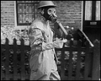

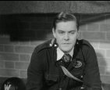

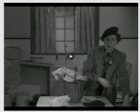
Films
If War Should Come (1939)
London Can Take It! (1940)
Post 23 (1941)
Make Do and Mend (1943)
Rationing in Britain (1944)
Notes:
All films from the collections of the Imperial War Museums
If War Should Come (1939): Imperial War Museums, ref COI 849 https://www.iwm.org.uk/collections/item/object/1060021953
London Can Take It! (1940): Imperial War Museums, ref COI 943 https://www.iwm.org.uk/collections/item/object/1060022009
Post 23 (1941): Imperial War Museums, ref UKY 315 https://www.iwm.org.uk/collections/item/object/1060006255
Make Do and Mend (1943): Imperial War Museums, ref NPB 13037 https://www.iwm.org.uk/collections/item/object/1060034062
Rationing in Britain (1944): Imperial War Museum, ref COI 155 https://www.iwm.org.uk/collections/item/object/1060021462

Slide 16
Oral histories/memoirs
1. “Night after night of the blackout we had. We'd take a flask of tea down the shelter and sit and chat down there. Every night at nine o'clock, though, I used to go and stand at the shelter and look out. I was the only one looking out like that. I must say I felt quite brave, although, you might think me rather foolish. The searchlights and the flashes of the anti-aircraft guns lit up the sky. It was all a sight.The guns were up on Dogkennel Hill. Even inside the shelter, you could feel the 'thump, thump' of them vibrating. I think they were trying to get the railway line. It was over that way. Their bombs were falling short and coming our way instead. And then there were the barrage balloons. I used to peer out and watch it all. It really was all such a sight what with all the bangs and explosions and everything. I just never imagined I'd grow up to see such things.” – Grace Seager Doe, Dulwich
Notes:
1. Grace Seager Doe, “A Londoner's War Diary”, in BBC WW2 People’s War (2005), at bbc.co.uk/history/ww2peopleswar/stories/77/a4457577.shtml, accessed 15 April 2020.

Slide 17
2. “This is a side of warfare that is unglorious, that someone has to face, a side that is rarely mentioned, a side of war that gets no medals, a side of war that if the bemedaled glory boys who wield the power, if they had to face it, would change their tunes." – Stanley Rothwell, Lambeth
Notes:
1. Grace Seager Doe, “A Londoner's War Diary”, in BBC WW2 People’s War (2005), at bbc.co.uk/history/ww2peopleswar/stories/77/a4457577.shtml, accessed 15 April 2020.
2. Stanley Rothwell, Lambeth at War, p 17, as quoted in https://spartacus-educational.com/2WWairwardens.htm, accessed 15 Apr 2020.

Slide 18
3. “On Friday the 1st of September, we assembled again at school early in the morning and walked in our procession to South Bermondsey Station… each wearing a label, gas-mask case on shoulder and carrying a case or bag. This time it was for real, and there was a special electric train waiting at the station, with plenty of room for all of us, but to the consternation of the big crowd of Mums and Dads who came to see us off, no-one could tell them where we were going… At last the journey ended and we found ourselves at Worthing, a seaside resort on the Sussex coast.” – Kenneth Haines, Bermondsey
Notes:
3. Kenneth Alford Haines, “A Bermondsey Boy’s War Part 1: 1939, Evacuation to Worthing” in BBC WW2 People’s War (2005), at bbc.co.uk/history/ww2peopleswar/stories/11/a2283211.shtm , accessed 15 April 2020.

Slide 19
4. “Most foods were on rations but Kennedy’s used to do sausages. Sausages weren’t rationed so mum would take two kiddies with her… and we used to have to queue up … to get a pound each. […] Some people were quite nasty to us because my mum had a big family she had more ration books. […] I used to hate to go shopping because of that. […] When my dad came home from work in the evening he would cut out the coupons and my young brother and I would go to the sweet shop where we would choose 2 ozs. of sweets each. We were able to have these as my older brothers and sisters gave up their rations for us. -- Barbara Little Stoneham, Camberwell
Notes:
4. Barbara Little Stoneham, “A London Family’s Story”, in BBC WW2 People’s War (2005), at bbc.co.uk/history/ww2peopleswar/stories/70/a8087970.shtml , accessed 15 April 2020.

Slide 20
Images

Slide 21
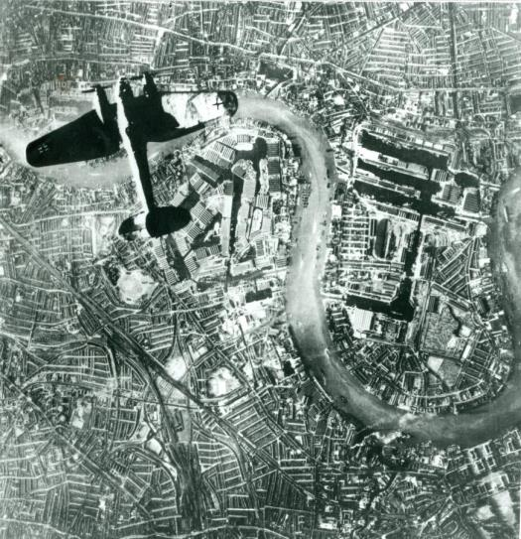
Heinkel 111 bomber over Surrey Docks, 7 Sep 1940
Southwark Archives, reference P20492
Notes:
Heinkel 111 bomber over Surrey Docks, 7 Sep 1940 (Southwark Archives, reference P20492: copies also known to exist in the archives of News UK, the Australian War Memorial, and the Imperial War Museum, (item C 5422))

Slide 22
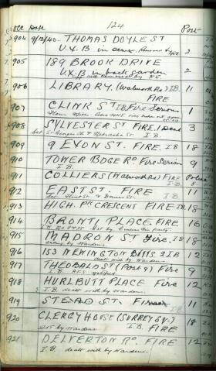
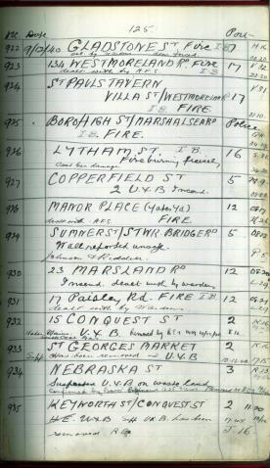
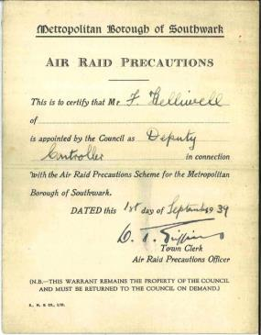
(L) MB Southwark incident register, 9/12/1940
Southwark Archives 5916
(R) MB Southwark ARP identification card, F Helliwell
From Southwark Archives, reference PC940.544
Notes:
(L) MB Southwark incident register, 9/12/1940: Southwark Archives reference 5916
(R) MB Southwark ARP identification card, F Helliwell: From Southwark Archives, reference PC940.544

Slide 23
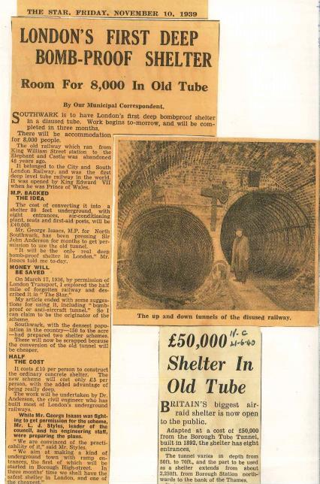
News stories on Southwark deep shelter
From Southwark Archives PC 940.544
Notes:
News stories on Southwark deep shelter: From Southwark Archives PC 940.544

Slide 24
Children waiting to board evacuation train, c 1 Sep 1939
Southwark Archives, image P20691
Notes:
Children waiting to board evacuation train, c 1 Sep 1939
Southwark Archives, image P20691

Slide 25
Aftermath, Stainer Street Arch bombing, 17 Feb 1941:
From Southwark Archives, reference P20437
Notes:
Aftermath, Stainer Street Arch bombing, 17 Feb 1941: From Southwark Archives, reference P20437

Slide 26
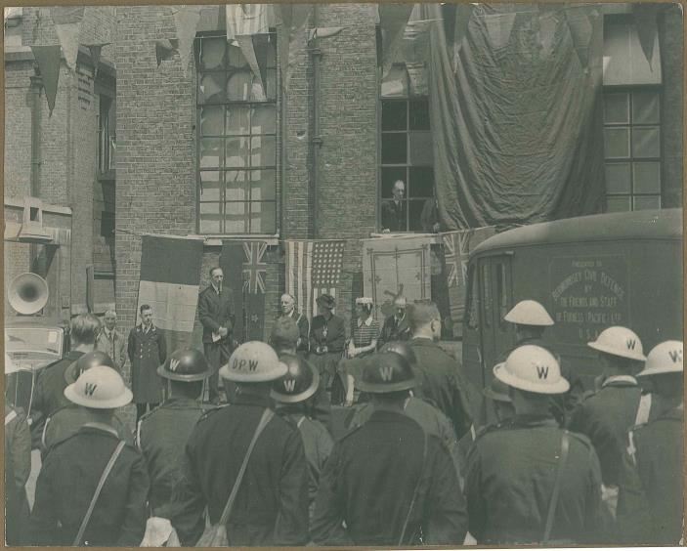
MB Bermondsey CD staff at rally, c 1943:
From Southwark Archives, reference P 4167

Slide 27
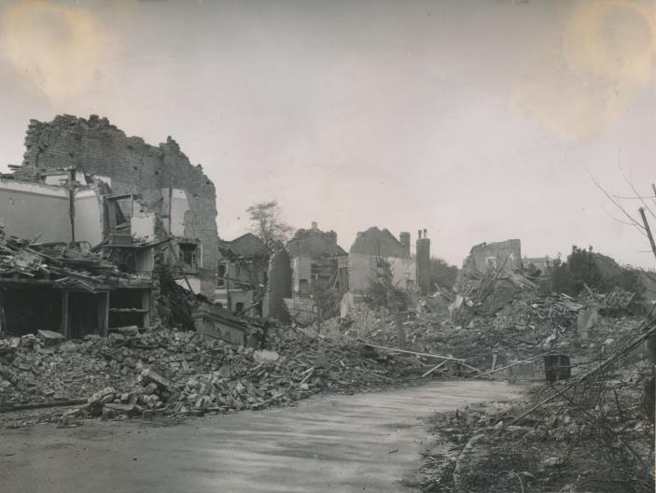
Damage from parachute mines, Camberwell, c 1943 :
From Southwark Archives, reference P 6922
Notes:
Damage from parachute mines, Camberwell, c 1943. Photograph by Barr: From Southwark Archives, reference P 6922

Slide 28
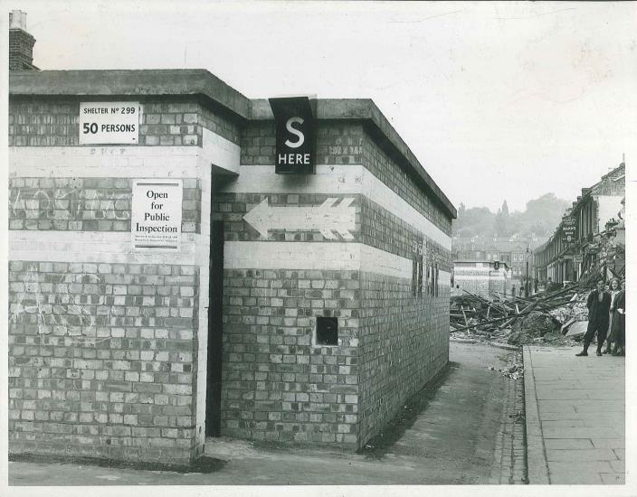
Above-ground air raid shelter, Camberwell, 1940:
From Southwark Archives, reference P 6893
Notes:
Above-ground air raid shelter, Camberwell, 1940: From Southwark Archives, reference P 6893

Slide 29
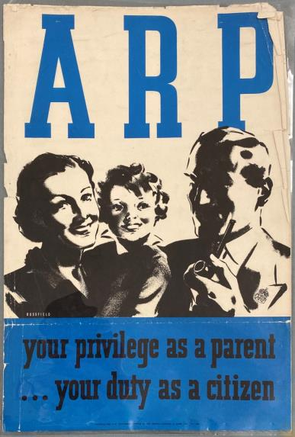
Centrally produced ARP recruitment poster:
From Southwark Archives, reference PC 940.544
Notes:
Centrally produced ARP recruitment poster: Southwark Archives, reference PC940.544

Slide 30
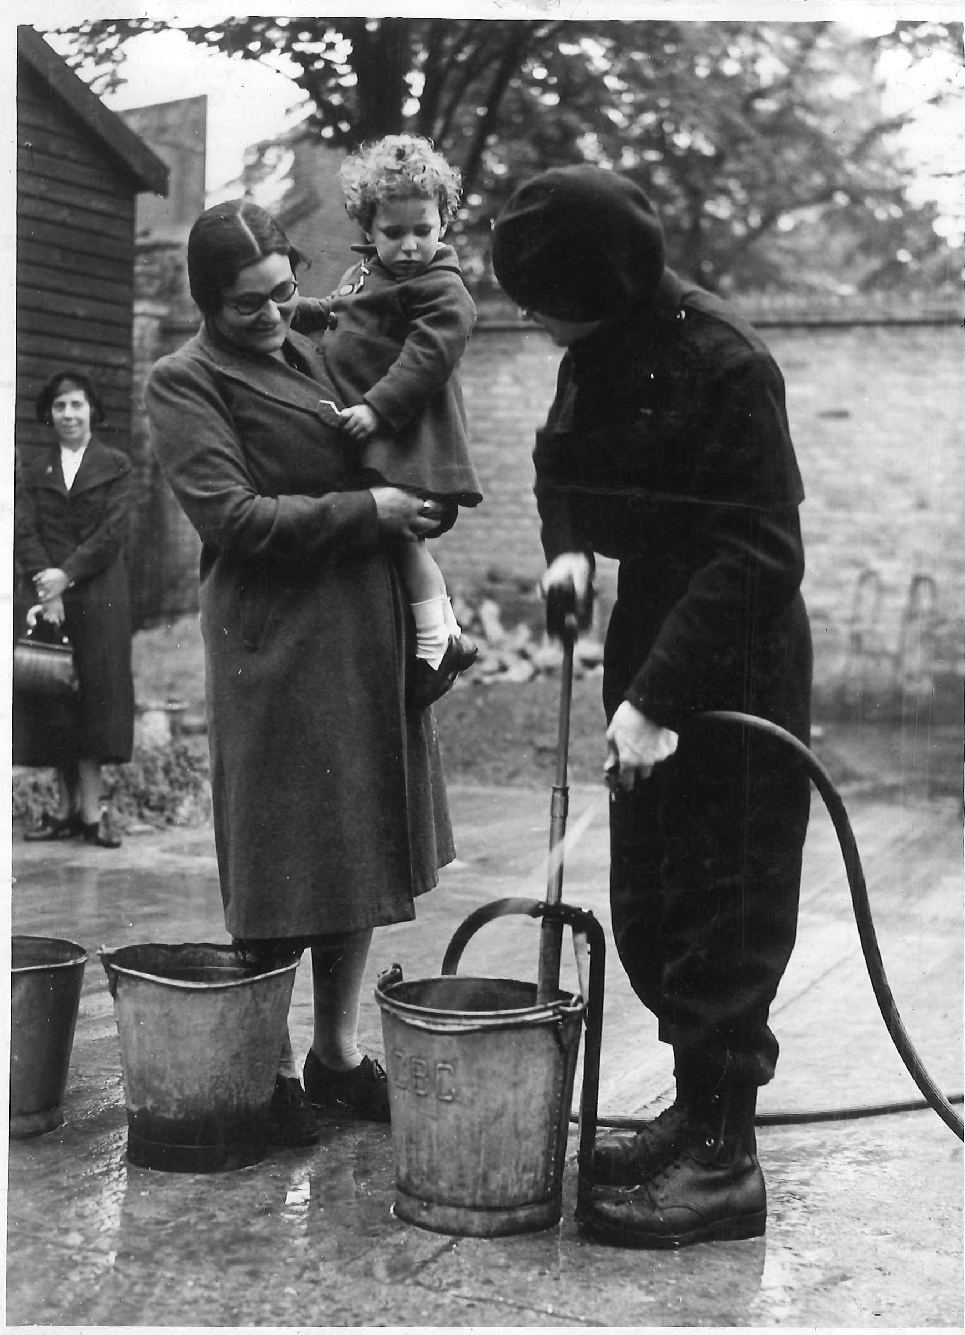
MB Camberwell CD staff demonstrating a stirrup pump: From Southwark Archives, reference P 5205
Notes:
MB Camberwell CD staff demonstrating a stirrup pump: Southwark Archives, image P 5205

Slide 31
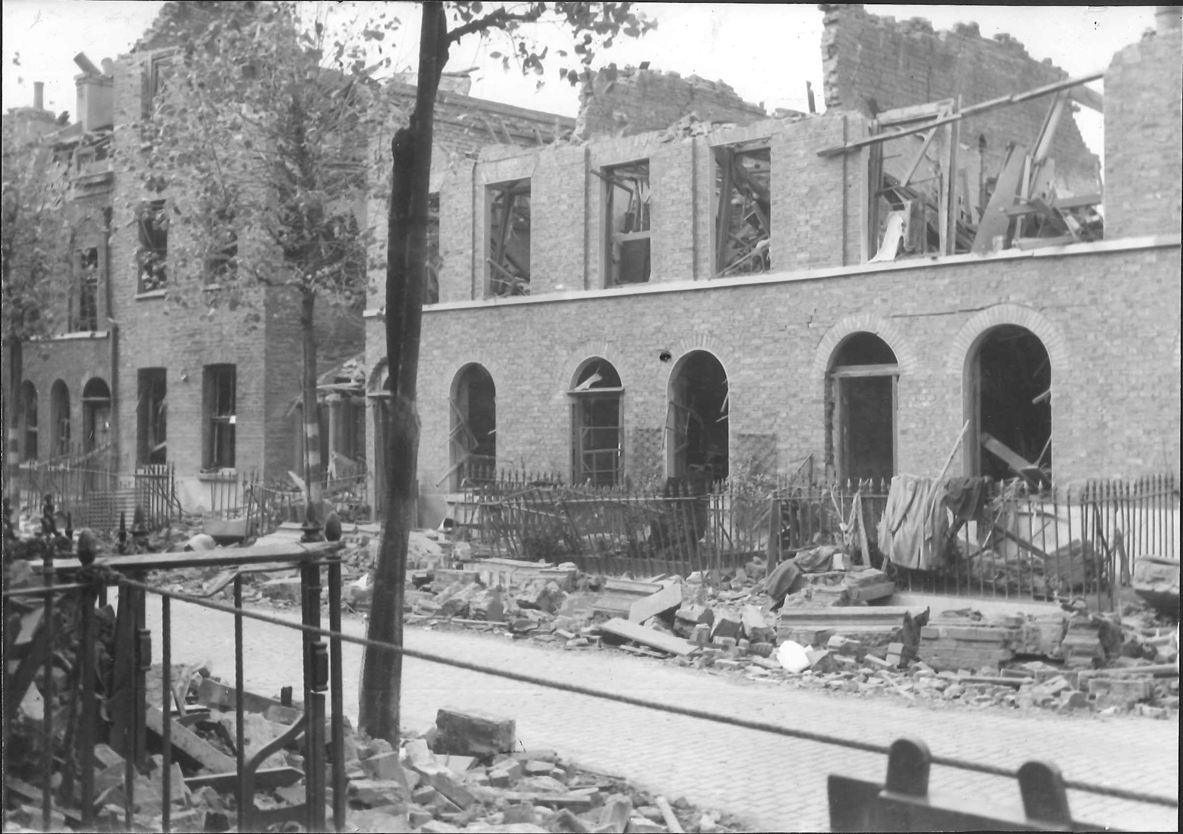
Bomb damage in Llewellyn Street, Bermondsey, Sep 1940:
:From Southwark Archives, reference PB 5241
Notes:
Bomb damage in Llewellyn Street, Bermondsey, Sep 1940: Southwark Archives, image PB 5241

Slide 32
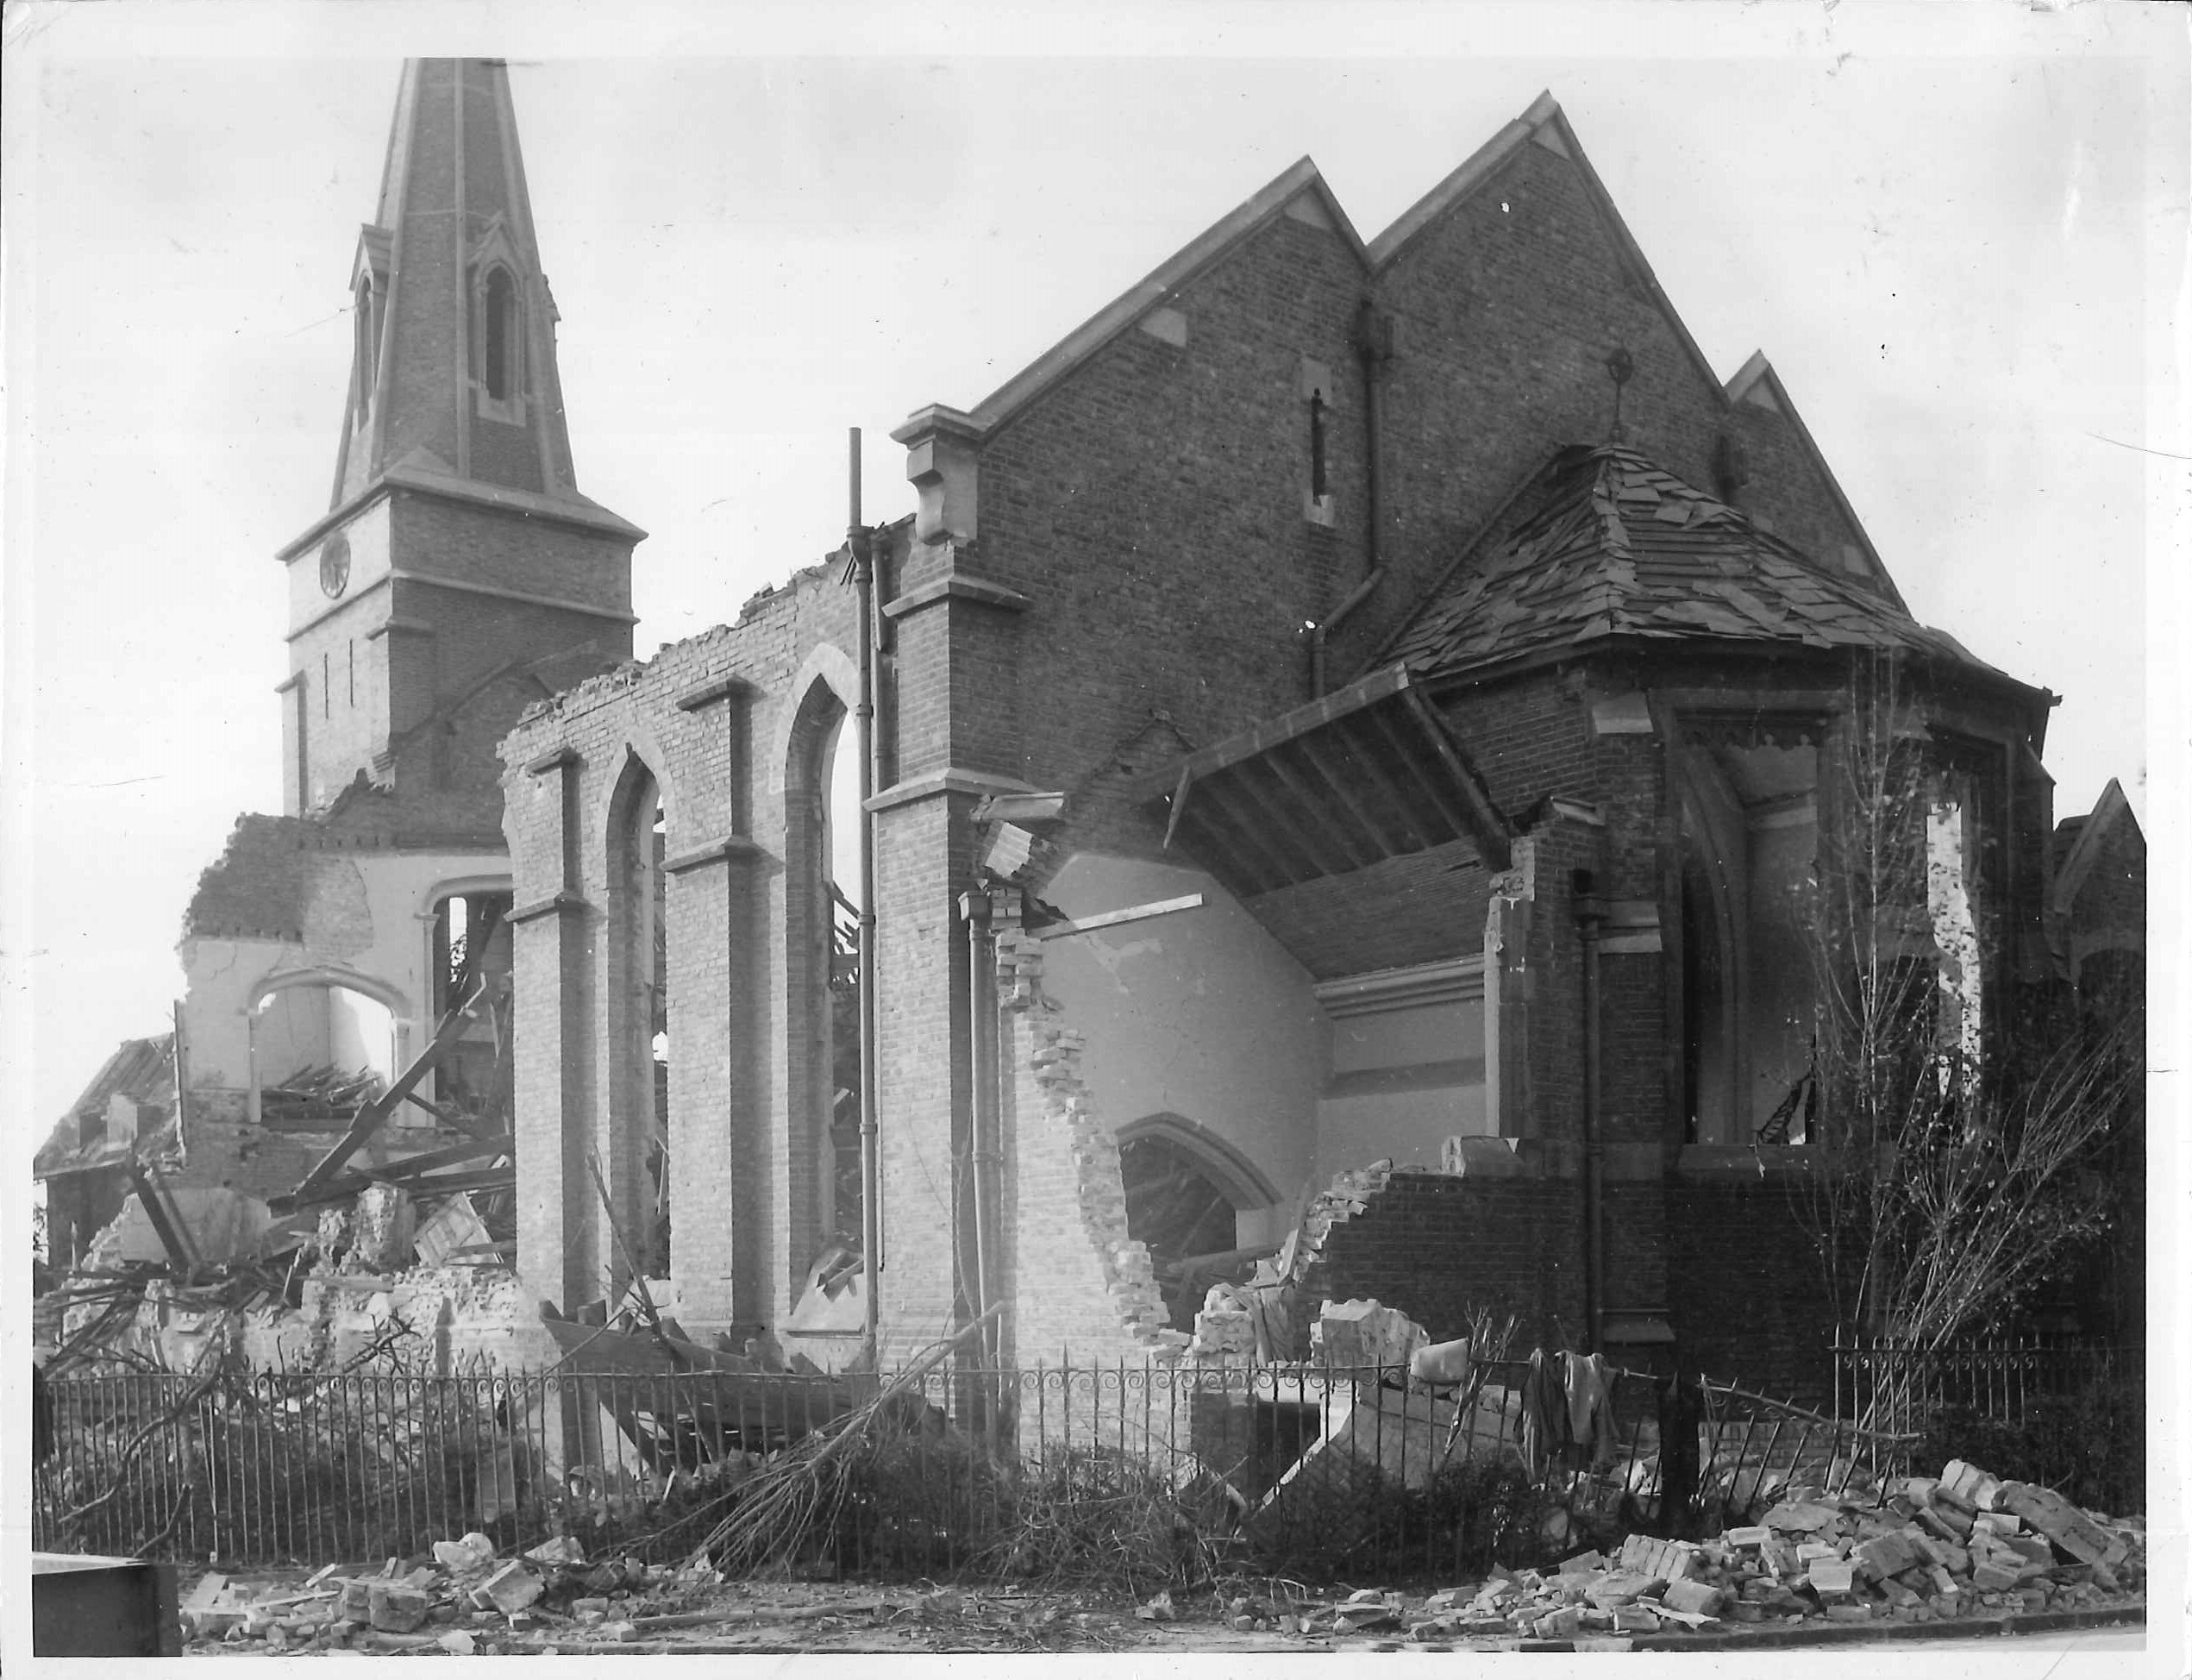
Air raid damage, St Mary Magdalene, Peckham, Fall 1940:
From Southwark Archives, reference P 6885
Notes:
Air raid damage, St Mary Magdalene church, Peckham, Fall 1940. Photograph by Barr: From Southwark Archives, reference P 6885

Slide 33
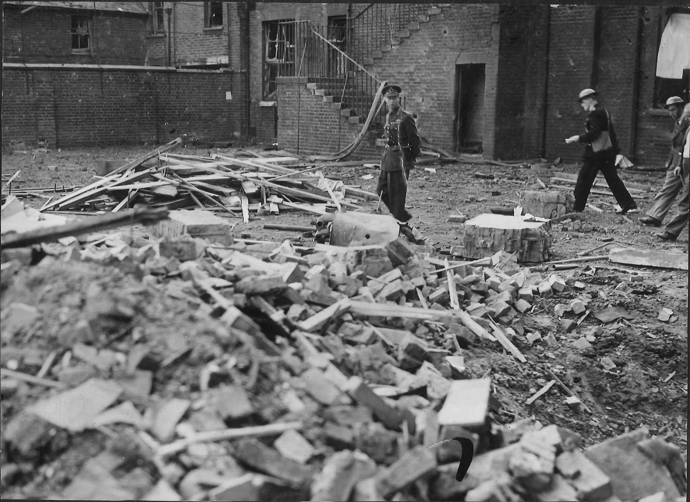
King George VI inspecting damage to Keeton’s Road School, Bermondsey, shortly after 7 Sep 1940:
:From the image collection of Southwark Archives
Notes:
King George VI inspecting damage to Keeton’s Road School, Bermondsey, shortly after 7 Sep 1940
From the image collection of Southwark Archives

Slide 34
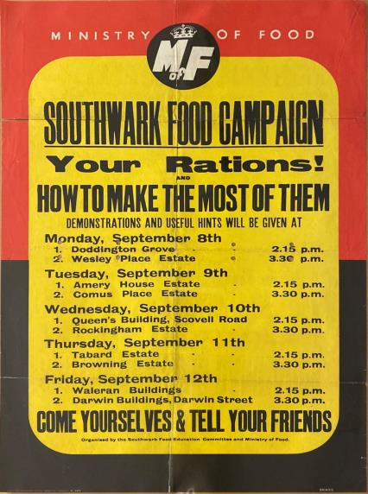
Poster advertising Ministry of Food/MB Southwark classes:
From Southwark Archives, reference POSTERS 940.544
Notes:
Poster advertising Ministry of Food/MB Southwark classes: Southwark Archives, POSTERS 940.544

Slide 35
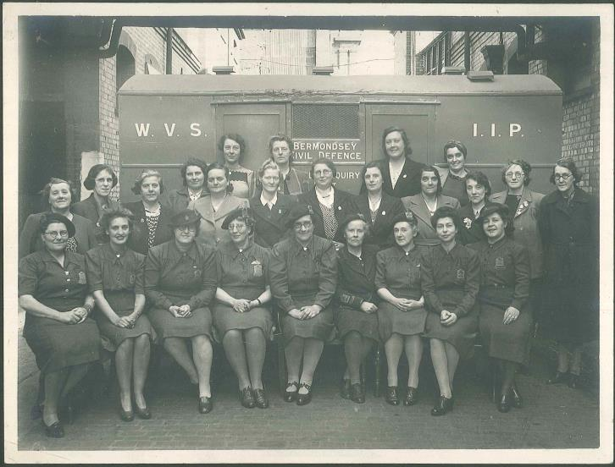
MB Bermondsey CD mobile enquiry unit and WVS staff:
From Southwark Archives, reference P 8467
Notes:
MB Bermondsey CD mobile enquiry unit and WVS staff: Southwark Archives image P 8467

Slide 36
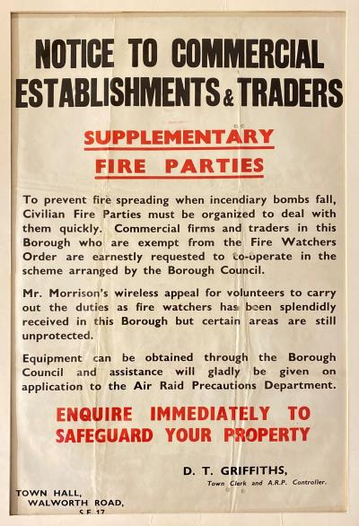
MB Southwark poster appealing for volunteer firewatchers:
From Southwark Archives, reference POSTERS 940.544
Notes:
MB Southwark poster appealing for volunteer firewatchers: Southwark Archives, POSTERS 940.544

Slide 37
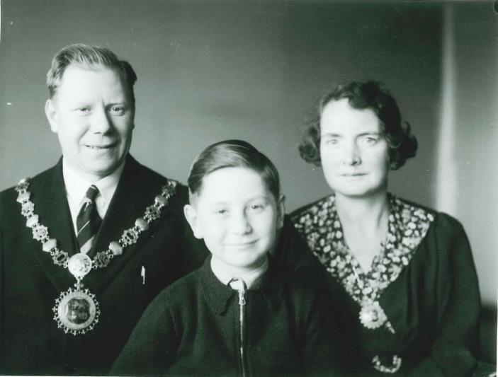
MB Bermondsey Mayor & Mayoress Albert and Gladys Verrell Henley (1940-41) with their son Len:
From Southwark Archives, reference P 17332
Notes:
Bermondsey Mayor & Mayoress Albert and Gladys Verrell Henley (1940-41) with their son Len: Southwark Archives image P 17332
Mayor Henley was killed during a raid on Bermondsey Town Hall, Spa Road, 9-10 May 1941

Slide 38
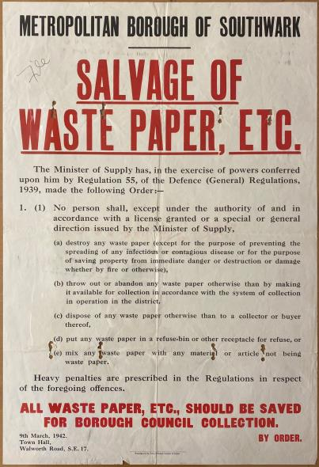
MB Southwark poster on waste paper recycling regulations: :
From Southwark Archives, reference POSTERS 940.544
Notes:
MB Southwark poster on waste paper recycling regulations: Southwark Archives, POSTERS 940.544

Slide 39
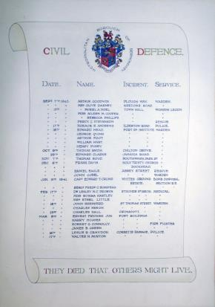
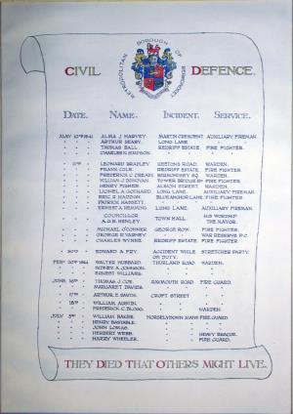
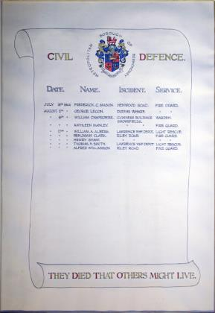
MB Bermondsey CD Roll of Honour:
From Southwark Archives, reference POSTERS 940.544
Notes:
MB Bermondsey CD Roll of Honour: Southwark Archives, POSTERS 940.544

Slide 40
Further information
Primary sources
Southwark Heritage Civilian War Dead Register
London Metropolitan Archives Layers of London
The National Archives Bomb Sight
Imperial War Museums BBC Sounds
BBC: WW2 People’s War
Secondary sources
Spartacus Educational topic: Second World War
History Extra topic: Second World War
BBC School Radio: Second World War
BBC Bitesize
BBC History
Notes:
If you would like to explore the home front further on your own, there are many places you can look. The Southwark Heritage website lets you explore the borough’s heritage collections and stories.
Because the London County Council and central government played vital roles on the home front, the London Metropolitan Archives and the National Archives hold records on wartime Southwark. These include the LCC Bomb Damage Maps, records on the evacuation of children, the 1939 Register, public information films, and the Bomb Census survey.
The Imperial War Museums explore the impact of conflict on individuals and society. Their collections include a wide variety of material related to the Second World War home front, including personal accounts, films, and photographs.
The Bomb Sight website offers an interactive map showing every site where bombs fell on London during the Blitz; the Layers of London website hosts an interactive copy of the LCC Bomb Damage Maps. The BBC’s archived website WW2 People’s War offers thousands of first-hand accounts of the Second World War from civilians as well as service personnel.
The Commonwealth War Graves Commission holds the Civilian War Dead Register, which gives details of all the casualties of Second World War air raids. BBC Sounds features broadcasts and other sounds from the home front.
A number of websites contain educational material on the homefront. They include History Extra, Spartacus Educational, and BBC History. BBC Bitesize has curriculum-based material aimed at teachers and students on the Second World War for KS2 and KS3.

